Slide 1



Post Fall Management | Getting to Types of Falls, Repeat Falls, and Determining Preventability
May 25th, 2022
Patricia Quigley
PhD, MPH, APRN, CRRN, FAAN, FAANP, FARN
Consultant, Nurse Scientist, nationally known for her extensive clinical practice, research and publications, policy influence on patient safety, fall and fall-related injury prevention, and research translation across settings of care.
Sponsored by
Disclaimer: The statements and opinions expressed by guest/s are their own and their appearance on this webinar (Strategies to Reducing Repeat Falls -Post Fall Management-05-25-22) does not imply an endorsement of such guest or any entity they represent. Furthermore, statements and opinions expressed by Curbell Medical employees or its representatives are those of such employees or representatives and do not necessarily reflect the views of Curbell Medical. All content herein should not be taken as medical advice and is for informational purposes only.

Slide 2


Webinars & Podcasts
Sponsored by
Webinars:
Patient safety webinars are offered quarterly and presented by clinical leader and patient safety expert Patricia Quigley PhD, MPH, APRN, CRRN, FAAN, FAANP, FARN. Each webinar offer best practices, innovations and solutions.
Find all past podcasts and webinars on the Curbell Medical Education Page
Podcasts:
Care Team Conversations, is a monthly patient safety focus podcast hosted by clinical leader and patient safety expert Patricia Quigley PhD, MPH, APRN, CRRN, FAAN, FAANP, FARN. Each episode Dr Quigley speaks to a different Nurse about best practices, innovations, and solutions, as well as their personal journey on becoming a Nurse.
Subscribe
Apple
Podcast
Stitcher
Podcast
Spotify
Podcast
Google
Podcast
Amazon
Podcast

Slide 3






Objectives
Participants will:
Affirm the vital role of a post fall huddle as a group consensus approach to determine the immediate/root cause of the fall
Differentiate the post fall huddle from other post fall management components (incident reports and medical record documentation)
Illustrate a post fall huddle program evaluation model.

Slide 4


Falls affect between 700,000 - 1,000,000 patients each year (AHRQ, Patient Safety Network [PSNet], Patient Safety Primer: Falls. Updated Sept. 2019)
Fall Rates: 3-5/1000 patient days (AHRQ, PSNet, Sept 2019)
More than 1/3 of in-hospital falls result in injury (AHRQ, PSNet, 2019)
Ranked among the most reported incidents in hospitals and other facilities (AHRQ, PSNet, Sept 2019)
Falls can lead to severe injuries, hip fractures, and head trauma
Burden
4

Slide 5

How do you know your fall prevention program is working?
Can you affirm that patients who fall more than once are not falling for the same reason?
How is your post fall program working?
How do you measure success?
Let’s Share!

Slide 6



Post Fall
Practices

Slide 7

How Many Huddles Are You Doing?
Huddles

Slide 8
Accident Theory
Hazards
8
Losses
Notes:
MANY DEFENSIVE LAYERS RELY ON PEOPLE, PROCEDURES OR PROTOCOLS TO STOP HAZARD FROM HARMING PT-ALL HAVE HOLES-OPEN AND CLOSE – MOMENTARILY ALIGN ALLOWING HAZRDS TO HARM PT

Slide 9
Post Fall Huddle (PFH)
A brief staff gathering, interdisciplinary when possible, that immediately follows a fall event.
Convenes within 15 minutes of the fall event
Clinician(s) responsible for patient/resident during fall event leads the PFH
Involves the patient/resident whenever possible in the environment where the patient/resident fell
Requires Group Think to discovery what happened.
Utilizes discovery to determine the root cause / immediate cause of the fall: why the patient/resident fell.
Guiding question to ask: What was different this time you were doing this activity, compared to all the other times you performed the same activity (and did not fall), but this time you fell?
Essential Components

Slide 10
Steps to the
TL makes announcement
Convene within 15 mins with the patient/resident in the environment where the patient/resident fell
Conduct Analysis: Determine root cause of fall, injury and Type of Fall
TL summarizes information gleaned from PFH and intervention(s) for prevention of repeat fall are decided by the huddle team.
TL completes of the Post-Fall Huddle Form and processes the form according to medical center policy and procedure.
Modifies the fall and injury prevention plan of care to include interventions to prevent repeat fall and injury
Communicate updated plan of care in patient/resident hand-off reports.
Complete EMR Post Fall Note
Post Fall Huddle

Slide 11
Decision Tree
Type of Fall
Post Fall Huddle
Determine Immediate Cause
What was different this time?
Immediate
Causes
Unpreventable
Falls
Examples:
Spill on floor
Trip over tubing
Broken equipment or furniture
Examples:
Postural hypotension
Weak or impaired gait
Confusion
Centrally acting medication
Examples:
Heart Attack
Seizure
Drop Attack
Types of Falls
Environmental
Known Intrinsic/Extrinsic Risk Factors
Unknown sudden condition that cannot be predicted before the first occurance
Types of Falls
Accidental Fall
Anticipated Physiological Fall
Unanticipated Physiological Fall
Determine Preventability

Slide 12
Determine Preventability
Step 1: Conduct the Post Fall Huddle.
Step 2: Determine the Immediate Cause of the Fall.
Step 3: Determine the Type of Fall.
Step 4. If Accidental and Anticipated Physiological Falls, determine Preventability:
Could the care provider (direct care provider) have anticipated this event with the information available at the time?
If the Answer is NO, the fall is Not preventable.
If the answer is YES, the provider must ask another question: Were appropriate precautions taken to prevent this event?
Answer:
  No, Clearly or likely Preventable;
  Yes, Clearly or likely Unpreventable
Levinson, D. R., (2010, Nov). Adverse events in hospitals: National incidence among Medicare beneficiaries
VA Falls Toolkit: Falls Decision Tree Typology

Slide 13



Don’t Morph This Form to Be Something Else!
Post Fall
Huddle Form

Slide 14


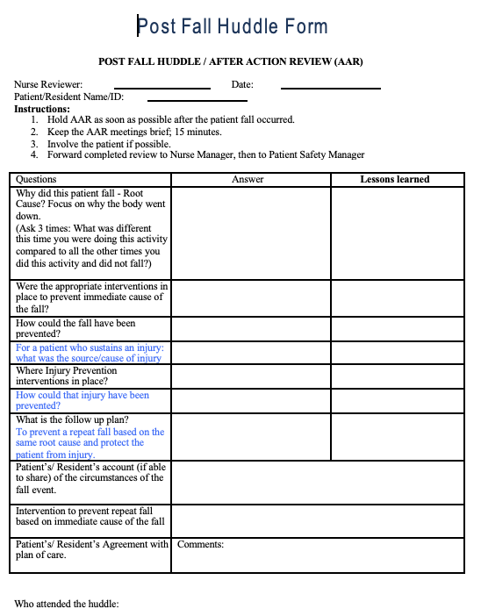
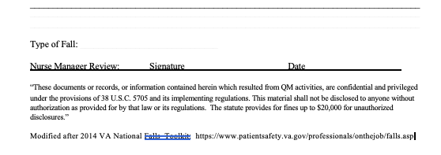
PFH Form

Slide 15
Outcomes of
Specify Root Cause (proximal cause) of fall and injuries
Specify Type of Fall
Identify actions to prevent reoccurrence
Changed Planned of Care
Patient / Resident (family) involved in learning about the fall occurrence
Mitigate / Eliminate root cause of fall and injury(ies)
Prevent Repeat Fall – same type and same cause
Eliminate sources of injuries
Reduce Repeat Fall and Fall-injury Rates
Post Fall Huddles

Slide 16

Post Fall
Huddle Resources
VA: Falls Toolkit
Post Fall Huddles
www.patientsafety.va.gov
AHRQ Falls Toolkit 2013

Slide 17
Tools
Post Fall Huddle Process
Decision Tree
Post Fall Huddle Form
Determine Preventability
Case Study Exercises
Audit Tool

Slide 18
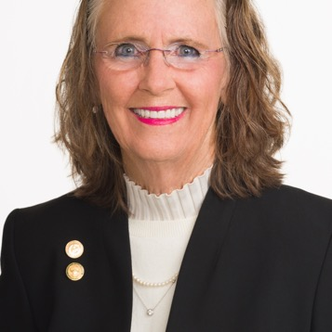
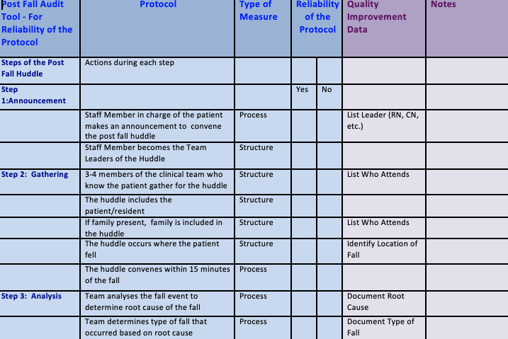
Let’s Take a Look –My Audit Tool

Slide 19
Evaluating PFH Program: Formative Measures
Structures:
Who attends: Nursing and others – Count them
Changed Plan of Care: Add actions to your run-chart: Annotated run chart; Capture interventions
Processes:
Timeliness of Post Fall Huddle (number of minutes)
Timeliness of changing plan of care
Time to implemented changed plan of care

Slide 20
Summative
Eliminate Repeat Fall: Same Root Cause and Same Type of Fall
Eliminate Recurrent Injury(ies): Same Root Cause(s)
Reduce costs associated with falls and fall related injuries
Outcome

Slide 21
Building Evidence about PFH
2 year demonstration project – quasi experimental study
16 small rural hospitals (avg beds 26)
Determine associations between conducting post fall huddles on repeat fall rates and perceptions of teamwork and safety culture
Jones, Crose, et al. (2019). The impact of post-fall huddles on repeat fall rates and perceptions of safety culture: A quasi-experimental evaluation of a patient safety demonstration project.

Slide 22

Collaboration and Proactive Teamwork Used to Reduce (CAPTURE) Falls purpose was to decrease the risk of falls in small rural hospitals by using an multi-team system (MTS) to implement evidence-based fall-risk-reduction practices.
MTS: core team, contingency team, coordinating team
Study Purpose

Slide 23
Results
308 pts; 64% had PFH; 347 falls; 223 falls after PFH
Aggregate mean repeat fall rate 1.12 (1.00-1.45)
{12% chance of a repeat fall}
Results demonstrate that the greater the proportion of falls in a hospital that are followed by a post-fall huddle, the lower may be the repeat fall rate.
Staff perceptions of teamwork were consistently high regardless of participation in a post-fall huddle.

Slide 24



Post Fall
Assessment
Different
than a
Huddle!
24

Slide 25
Post Fall
In-depth Data Gathering
Circumstances of the Fall
Patient/Resident Presentation
Assessment of Patient/Resident Condition
Assessment

Slide 26
Comprehensive Post-Fall Assessment
Includes:
General information about the fall
Subjective & objective falls documentation
Patient/Resident Assessment – vital signs; visible signs of injury (type & pain scores); glucometer (if diabetic or facility policy); Glasgow Scale (if suspected brain injury) and Morse Falls scale
Interventions based on Fall Risk Scale/ Morse falls scale
Facility personnel and family notification

Slide 27
Post Fall Assessment
Review of Systems
Patient Systems to Elicit on History Linked to Risk Factors
Symptom | Fall Risk Factor
Visual disturbance (double vision, blurry vision, loss of vision) | Visual impairment?
Dizziness/lightheadedness | Orthostatic hypotension? Abnormal vital signs?
Leg weakness | Gait or balance instability?
Urinary urgency or frequency | Urinary incontinence
Syncope/loss of consciousness | One or more chronic diseases
History

Slide 28
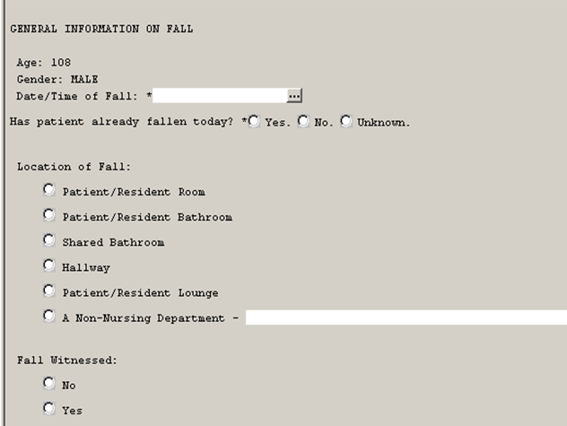
Post Fall Note (EMR)
If non-nursing department, can type in location of fall
Fall Witnessed – Yes or No (i.e. no other choices or drop-downs

Slide 29
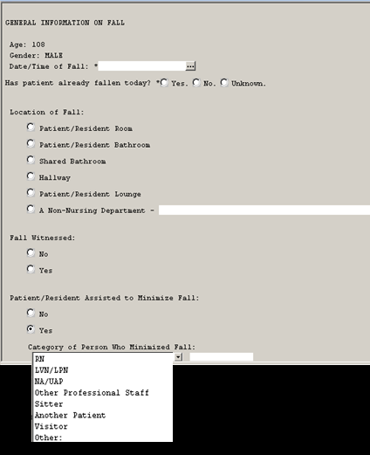
Gen Info
If patient/resident assisted to minimize fall – these are answer options for ‘Yes’ selection; added PT, OT

Slide 30
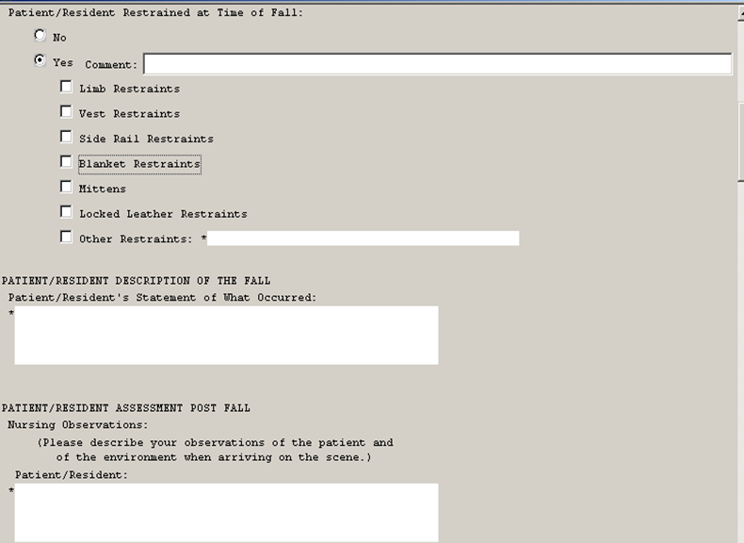
Options if ‘Yes’ selected for pt/resident restrained at time of fall’
Text boxes for pt/resident description of what occurred, as well as nursing description of pt/resident & environment at time of fall

Slide 31
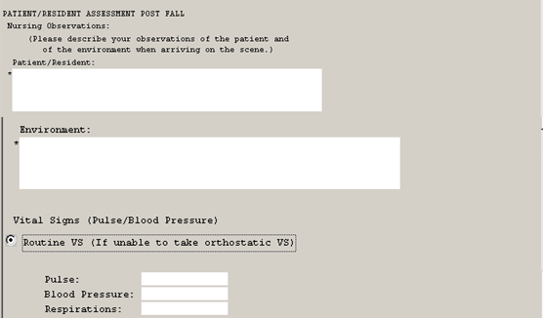
Enter routine Vital Signs (VS) if unable to take orthostatic VS

Slide 32
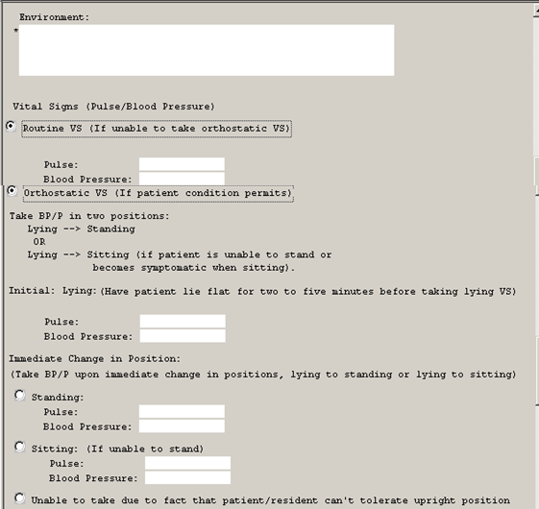
Clicking on ‘orthostatic VS’ opens instructions and ability to document vitals

Slide 33
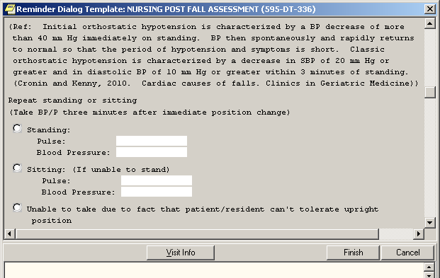
Orthostatic BP Reference/instructions

Slide 34
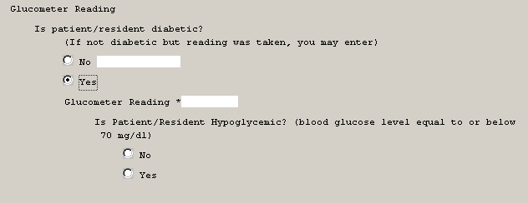
Notes:
Provide option for glucometer that is not required?

Slide 35
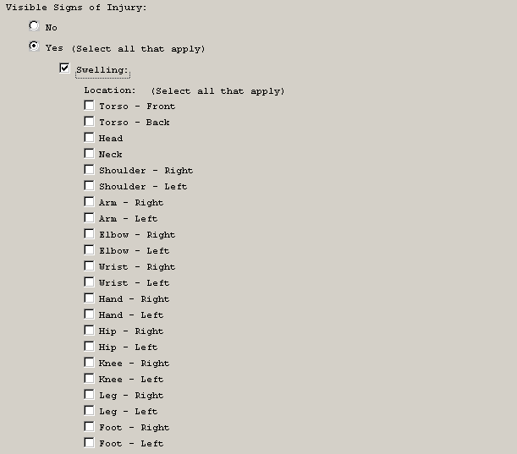
If yes to visible signs of injury, type of injury can be selected (e.g. deformity); selection prompts nurse to select location on pt/resident body

Slide 36
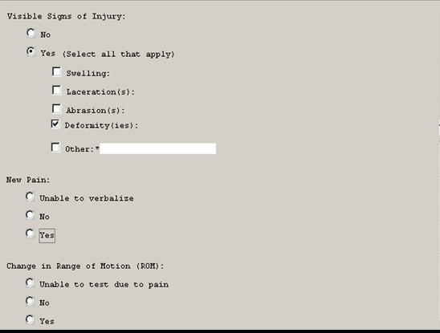
Physical assessment – New Pain or Change in Range of Motion – If selection is ‘Unable to Verbalize’ or ‘No’, can go on to next question (includes list of locations, including other as comment with pain rating

Slide 37
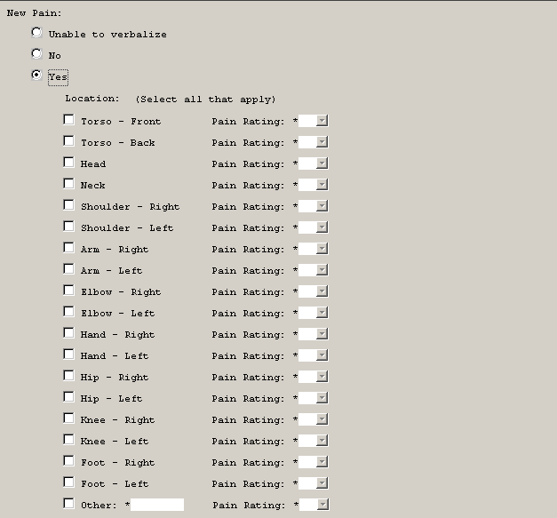
New Pain – if yes, can select location and pain rating for that location (1-10) scale

Slide 38
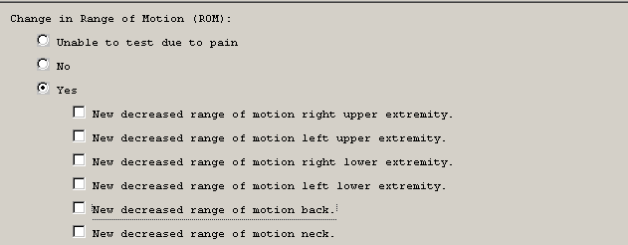

Change in ROM: if yes, select body area involved –
If no suspected or actual head impact, select ‘no’ and move on

Slide 39
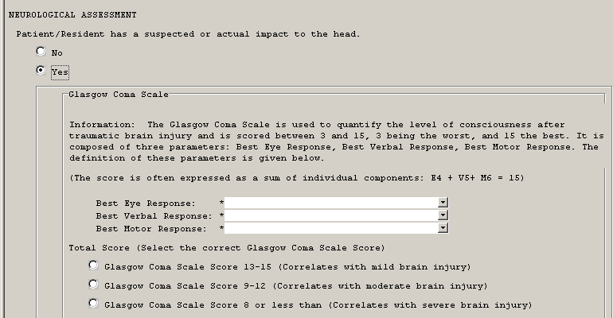
If Suspected or actual impact to head: ‘Yes’ selection opens Glasgow Coma scale and guidance
Adding up the Eye, Verbal, and Motor scores correlates with mild, mod, or sever e brain injury

Slide 40
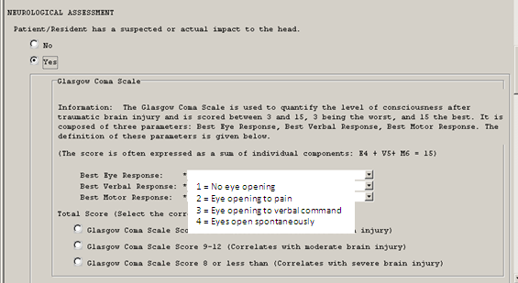
Scoring options for Best Eye Response

Slide 41
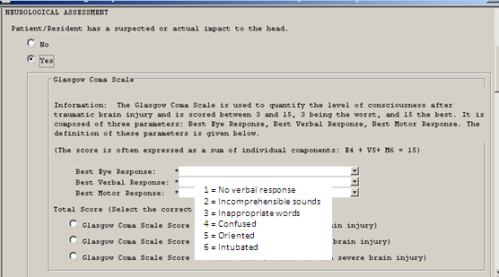
Scoring options for Best Verbal Response

Slide 42
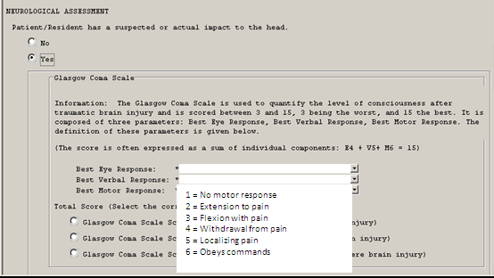
Scoring options for Best Motor Response

Slide 43
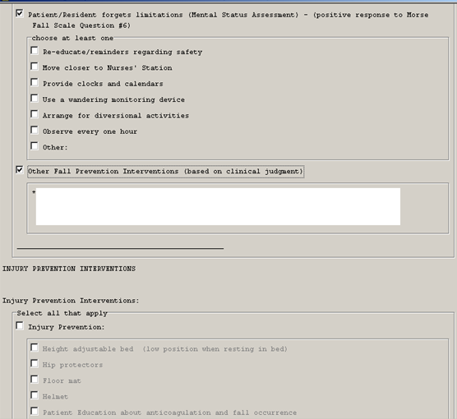

Slide 44
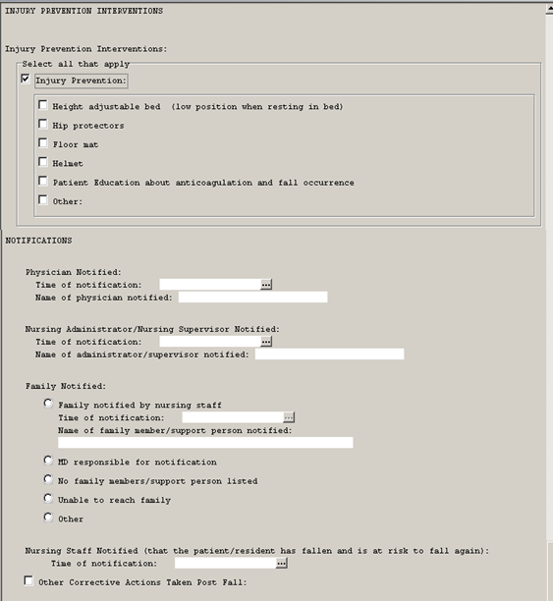
Preventive intervention selections

Slide 45

Teaching:
After a Fall
Reframe patient/resident education curricula to include "what happens after a fall".
What can we learn from this event?
How can we work together to prevent this again?

Slide 46


Universal Fall Prevention
Individualized Fall Prevention
Injury Reduction Strategies
Root Cause Trends of Falls and Injuries
Interventions for Improvement
Impact of Changes in Practices
Staff Education

Slide 47
My Unit Story Board
RC: Root Cause CA: Corrective Action DOI: Date of Implementation DOR: Date of Resolution
Annotated Story Board Fallers 5So Med Surg
0
1
2
3
4
5
6
RC
RC
RC
RC
RC
CA
CA
CA
CA
CA
DOI
DOI
DOI
DOI
DOI
DOR
DOR
Sunday Monday Tuesday Wednesday Thursday Friday Saturday

Slide 48
Learn from Falls:
Talk About and Trend Root Causes
Trend Interventions for Mitigation/Elimination of Root Causes: Changes to improve safety – clinical practice and environments
Align Interventions to Type of Falls
Precision In Program Evaluation: Reduction
  Accidental Falls
  Anticipated Physiological Falls
  Unanticipated Physiological Falls
Change Your Conversation

Slide 49






To Change Practice is Not for the Faint of Heart
Patience
Transparency
Data
Perseverance
Positive Approach
Champions
It takes a lot of work:

Slide 50

Aug 24th, 2022
Strategies to Reducing the Risk for Hip Fractures
Sept 21st, 2022
National Fall Prevention Day • Program Evaluation: Increasing Program Evaluation Precision
Mark your calendar for future webinars
50

Slide 51

Thank You!
I hope this helps!
You can always reach me!
pquigley1@tampabay.rr.com

Slide 52

Fall Prevention Webinar Series
Event sponsored by
Post Fall Management: Getting to Types of Falls, Repeat Falls, and Determining Preventability
05/25/22
The following slides contain the information and links referenced throughout this webinar. Please feel free to reach out to us with any questions about the information or the products.
greamsnyder@curbellmedical.com

Slide 53
References
AHRQ, Patient Safety Network [PSNet], Patient Safety Primer: Falls. Updated Sept. 2019). Available: https://psnet.ahrq.gov/primer/falls
Ellis S, Mendel R, Nir M. (2006). Learning from successful and failed experience: The moderating role of kind of after-event review. J Appl Psychol;91(3):669–80.
Jones, K.J.,. Crowe, J., Allen, J.A., Skinner, A.M., High, R., Kennel, V., & Reiter-Palmon, R. (2019). The impact of post-fall huddles on repeat fall rates and perceptions of safety culture: a quasi-experimental evaluation of a patient safety demonstration project. BMC Health Services Research. 19: 650: https://bmchealthservres.biomedcentral.com/track/pdf/10.1186/s12913-019-4453-y.pdf

Slide 54
References
National Falls Toolkit. (2014). Post fall huddle resources. Department of Veterans Affairs. https://www.patientsafety.va.gov/professionals/onthejob/falls.asp
Preventing Falls in Hospitals. Content last reviewed March 2021. Agency for Healthcare Research and Quality, Rockville, MD. https://www.ahrq.gov/patient-safety/settings/hospital/fall-prevention/toolkit/index.html
Tannenbaum SI, Cerasoli CP. (2013). Do team and individual debriefs enhance performance? A meta-analysis. Hum Factors, 55(1):231–45
Care Team Conversation Podcast [E01S01] (2022) Determining Fall-Risk Patients: Assessments VS Screenings https://podcasts.apple.com/us/podcast/care-team-conversations/id1611606766

Slide 55
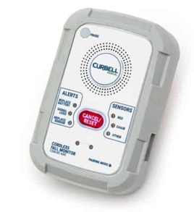
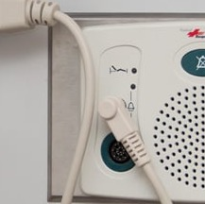
Curbell Medical
Bed
Sensor Pads
Chair
Sensor Pads
Fall Management Monitors
Fall Management Products
Floor Mat
Sensor
Seat Belt
Sensor
Fall Management Accessories

Slide 56
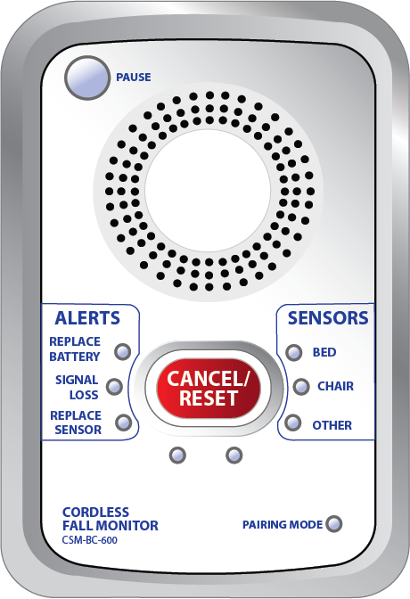


BC600 Cordless/Corded FM Monitor
PAUSE gives the caregiver 60 seconds
to remove the patient from the sensor
without causing an alarm.
Clinician Input Design! Simple to understand and easy to use for caregiver day to day use:
Clearly labeled, easy to read buttons and LED indicator lights
Setup functions kept out of sight in battery compartment
      Delay control* 🞡
      Tone switch
Volume
Nurse call jack allows direct notification to nurse call
Silent option when connected to Nurse Call 🞡
Can be used with both cordless and corded sensors
60 Second Alarm Pause* 🞡
Can control up to three cordless devices at the same time
3 AA Batteries - 6 Month Battery Lifespan
SENSORS identify which
sensor initiated the alarm.
*Reduces False Alarms
🞡Reduces Alarm Fatigue
CANCEL/RESET flashes when an
alarm is triggered making it more
noticeable for the caregiver
Click here for more product information
ALERTS show when to replace the
batteries or sensor pad and if there
is a lost signal.

Slide 57
CS-WMS Wireless Motion Sensor
ANTENNA to improve signal strength
Provides reliable infrared motion detection in light and dark conditions. It can be used as a standalone device or as an accessory for the BC600 fall management monitor. When a patient passes through the detection area, the CS-WMS will be triggered and will either sound an alarm or send a wireless signal to the BC600 to alarm:
SENSORS identify motion sensor’s status
STATUS
Can be mounted on a wall above bed, chair, doorway or above a toilet
Compatible with BC600 cordless monitors
Narrow detection angle with adjustable distance
Stand alone option
3 AA Batteries - 6 Month Battery Lifespan
ALARM/OFF/TRANSMIT
RESET/
PAUSE
RESET/PAUSE cancels alarm or pauses from triggering 15 seconds.
TRANSMIT MODE when switched to, a signal is sent to a BC600 monitor, which is connected to the nurse call system to provide an alarm at the nurse’s station.
ALARM MODE when switched to, the Wireless Motion Sensor will sound an audible alarm when motion is detected.
Click here for more product information

Slide 58
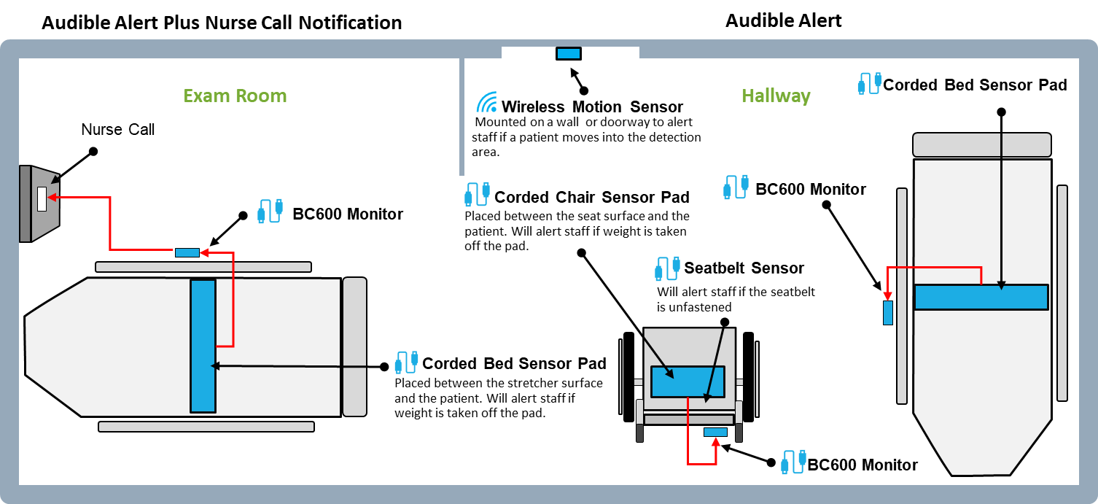
Curbell Sensors for the ER

Slide 59
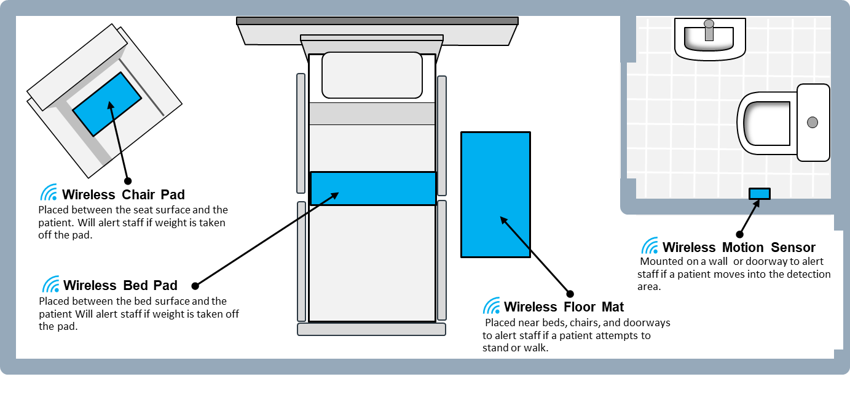
Curbell Wireless Sensors for the Hospital Room

