Slide 1
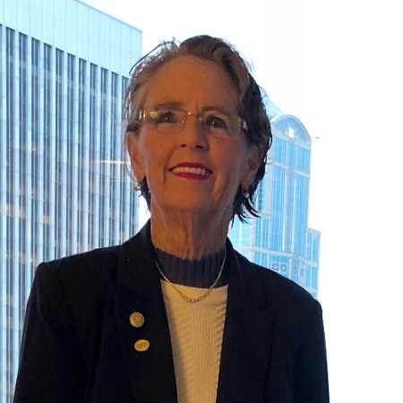

National Fall Prevention Awareness Day
September 22, 2021
Patricia Quigley
PhD, MPH, ARNP, CRRN, FAAN, FAANP, FARN
Event sponsored by

Slide 2

A Guide to Analyzing Fall and Injury Prevention: Leverage Technology to Customize Your Fall and Injury Prevention Program
By Dr. Patricia Quigley

Slide 3
National Falls Awareness Day is September 22nd
Focus is to prevent fall-related injuries among older adults (NCOA, 2021)
Lead and engage in education of older adults, their families about the consequences of fall and the interventions that can be implemented to reduce their risks, promote safety, function and independence.

Slide 4

My Goals:
Challenge and inspire you to go beyond universal fall precautions to use available and innovative technology to integrate in fall and injury reduction practices.
Shape population-based approach for high vulnerability that must be protected using new approaches to care.

Slide 5

Objectives:
Apply at least 3 strategies to change practice beyond usual care to focus on preventable falls and protection from injury;
Assess Readiness to Protect Patients from Harm due to Falls
Align Technology to Patient and Setting Specific Needs
Generate confidence to embrace innovation and inspire successful implementation

Slide 6

The Burden of Falls is Great
CDC’s Updated analysis of 2019 unintentional injury deaths, which again includes death due to falls, was the third leading cause of unintended injury death for the entire US population.

Slide 7
By Age Group, Unintentional Injuries by all ages, gender and race.
By age group, unintentional injury death was the
3rd leading cause of death in infants < 1 yoa;
1st leading cause of death in age groups 1-4, 5-9, 10-14, 15-24, 25-34, 35-44;
3rd leading cause of death in age groups 45-54, 55-64; and, 7th leading cause of death in older adults >65 and older.

Slide 8
Loss of Life
However, falls was the leading reason for unintentional injury death for older adults. Out of a total of 60,257 unintentional injury deaths, the leading cause is falls, 56.5% of all causes of unintentional injury death.

Slide 9
Every Day, Minute, Second Counts
Every year, approximately 3.7 million Americans turn 65. According to Factora, et al., (2021), older adults ages 65 years and older are twice as likely to fall than younger adults (OR 2.84 [1.77-4.53]). Every 11 seconds, an older person visits the ER due to a fall (National Council on Aging [NCOA, 2021). Every 20 minutes in the United States, an older adult dies from a fall (CDC STEADI, 2020).

Slide 10
Let’s talk about every second of every day:
Every second,
an older adult falls,
and every year
there are…
30M
FALLS
7M
INJURIES
3M
ED VISITS
900K
HOSPITALIZATIONS
30K
DEATHS
https://www.cdc.gov/steadi/pdf/Steadi-Coordinated-Care-Final-4_24_19.pdf

Slide 11

Fall Death rates are
on the rise!
Deaths Rates Per 100,000
64
62
60
58
56
54
50
48
46
44
42
about
30%
In the past decade
2009 2010 2011 2012 2013 2014 2015 2016 2017 2018
Year
Deaths from Older Adult Falls (cdc.gov)

Slide 12
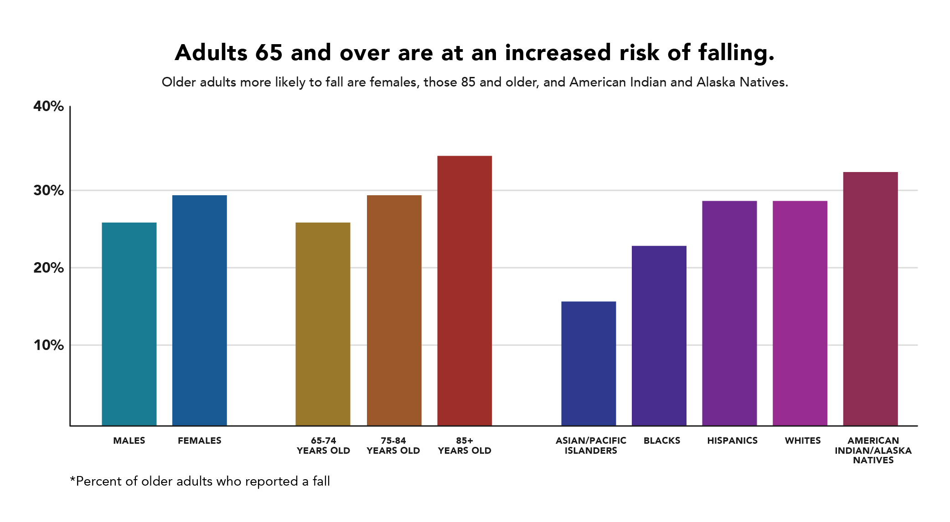
Age 65 and Older

Slide 13

ARHQ Data Informs Us More Work to Do
Public and private efforts reduced hospital-acquired conditions by 13 percent from 2014-17, helping to prevent more than 20,000 deaths and saving $7.7 billion in healthcare costs.
That's welcome news, but given that there are as many as 400,000 preventable deaths from medical mistakes each year, we wonder why more health systems aren't rushing to implement proven safety and quality solutions.
https://www.beckershospitalreview.com/quality/with-medical-errors-persisting-why-aren-t-cost-effective-safety-and-quality-solutions-gaining-more-traction.html
Notes:
Dreher, M., Quigley, P., Rick, C., & Weston, M. (2019, Dec) With medical error persisting, why aren’t cost-effective safety and quality solutions gaining more traction? Becker’s Hospital Review e-Weekly, Dec. 31
https://www.beckershospitalreview.com/quality/with-medical-errors-persisting-why-aren-t-cost-effective-safety-and-quality-solutions-gaining-more-traction.html

Slide 14

The Scope of Patient Risk
“What’s the Problem”
While much effort and attention has been focused on reducing hospital adverse conditions, patient fall with injury, harm still occurs
Need to “step up our game” and move at a more robust pace
Share success stories; spread solutions

Slide 15

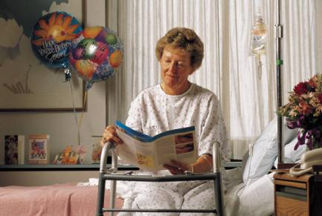
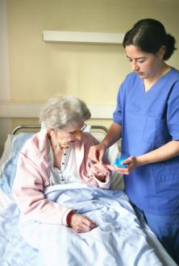
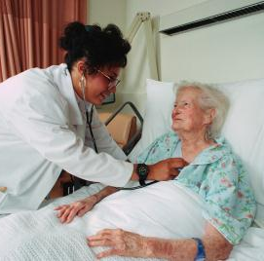
The Face of “Harm”
Notes:
So above all, we need to keep the patient at the center of our drive for improvement. Every incident of harm has a face, person and family associated with it whose lives are dramatically altered when an event of this nature takes place.

Slide 16
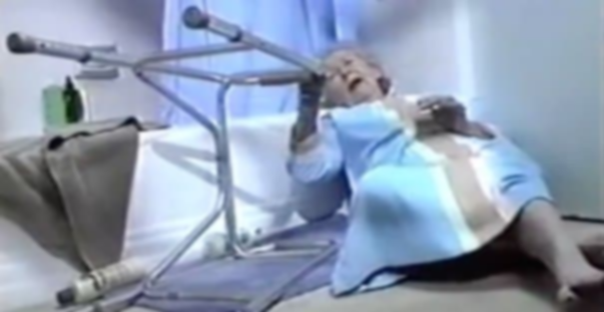
I’VE FALLEN AND I CAN’T GET UP!
HELP!
Notes:
16

Slide 17

Commit To Individual-Population-Based Care:
Move from Risk Screening to Assessment
  Stop over reliance on screening tools
Differential Diagnosis
Individualized Care Planning
Identify fallers from non-fallers
Identify those with injury hx or at risk for injury
Protect Patients from Injury
Implement Surveillance / Detection Methods

Slide 18

Select and Leverage Patient Engagement Technology
Safe Exit Sides
Bed / Stretcher Exit Alarms
Call Systems
Bathrooms entrance alarms/Movement Alarms
Think Safe Environment in All Settings of Living and Care

Slide 19

What can we change to move faster?
Understand that just about everyone is at-risk for a fall (don’t talk it about it anymore!)
Set and be accountable for achieving bold goals. In our care:
  No death, head trauma or hip fractures
  Reduce Preventable Falls
Mitigate or eliminate patients' modifiable fall risk factors
Guide to Analyze Fall and Fall Injury Prevention:
Program Attributes
Safe Environment
Individualized Care
Injury Prevention
Post Fall Management
Program Evaluation

Slide 20

Screening to Assessment
History of Falls
History of fall injury or injury risk factors
Assessment must be comprehensive
  Cognition
  Communication Status
  Mobility Abilities / Deficits (gait, balance, assistive devices, position sensing devices)
  Involve interdisciplinary team (nursing referrals to PT, PharmD, Bioengineering, etc)

Slide 21
Integrate Technology: Focus on 4 Opportunities
Safe Exit Sides
Bed / Stretcher Exit Alarms
Call Systems
Bathrooms

Slide 22

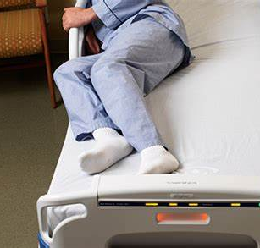
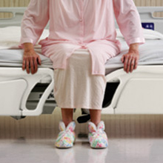
Safe Exit Sides

Slide 23

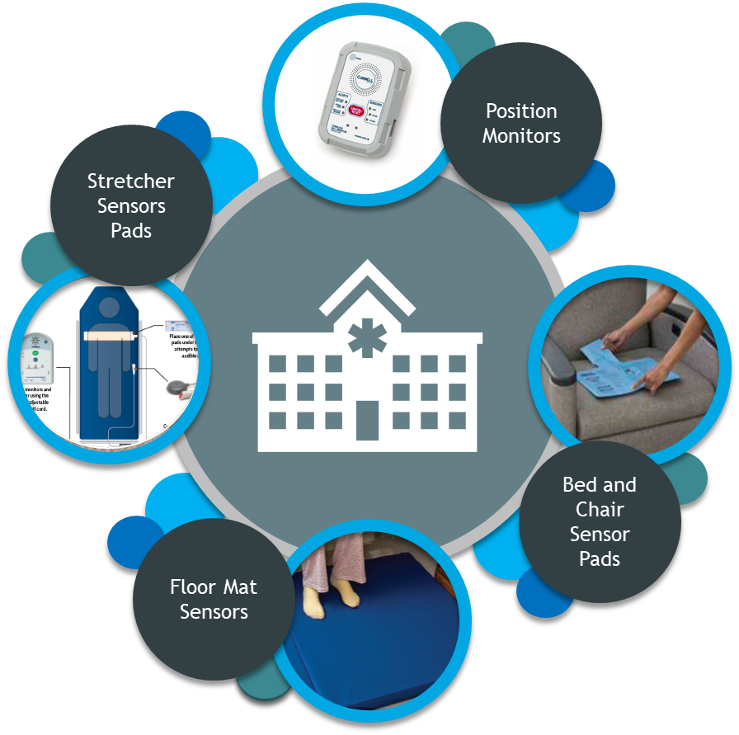
Bed / Stretcher Exit Alarms
Solutions – Cognitively Alert vs Impaired; Communication Stats
Alarming / Non-Alarming
Aligned to Nurse Call Systems
www.curbellmedical.com/fall-management

Slide 24


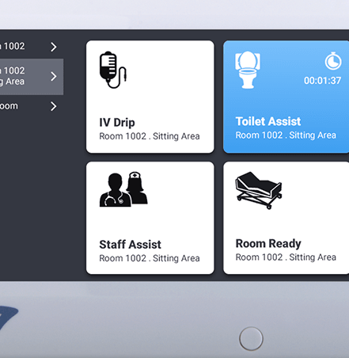
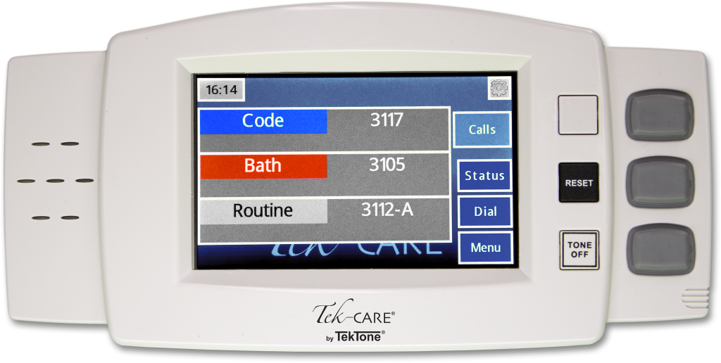
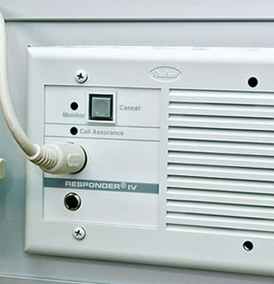
Call Systems

Slide 25
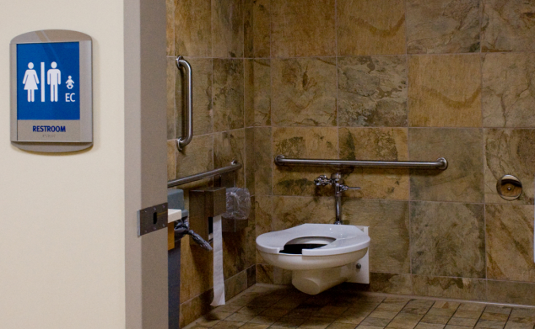
What’s the Matter with This?
Notes:
https://www.mnhospitals.org/Portals/0/Documents/ptsafety/falls/CreatingASafeEnvironmenttoPreventToiletingRelatedFallsReport.pdf

Slide 26
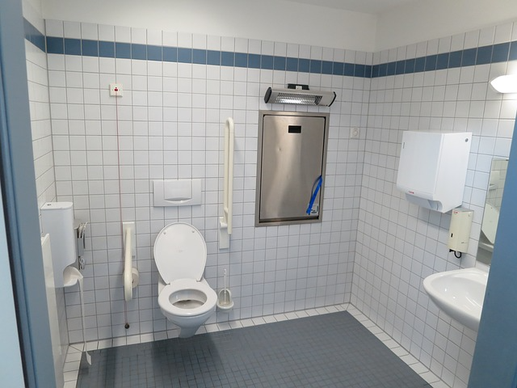
Redesigned for Patient Safety

Slide 27
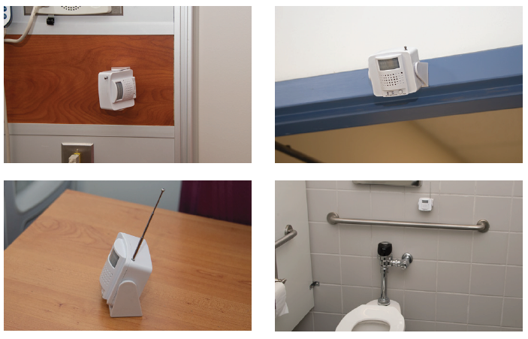
Curbell Toileting Solutions
Wireless Motion Sensor
  Will alarm to notify staff if the patient enters the toileting area unattended or can be position to be used when a patient is getting of the toilet without assistance
      Cordless solution
      Mounts to wall or can be set on a shelf
      Replaces traditional toilet seat sensors
      Aligned to Nurse Call Systems when paired with Curbell’s BC600 monitor
www.curbellmedical.com/wireless-motion-sensor/
Notes:
MOTION SENSOR The CS-WMS Wireless Motion Sensor can be used as a standalone device or as an accessory for the BC600 Fall management monitor that connects into nurse call systems. When a patient passes through the detection area the CS-WMS will be triggered and will either alarm or send a wireless signal to the BC600 to alarm. The CS-WMS is cordless and can be placed on a night stand or be mounted on a wall.
TOILET SENSOR PAD This sensor mounts discreetly underneath the toilet seat so that a patient can be monitored by staff without a loss of privacy.

Slide 28

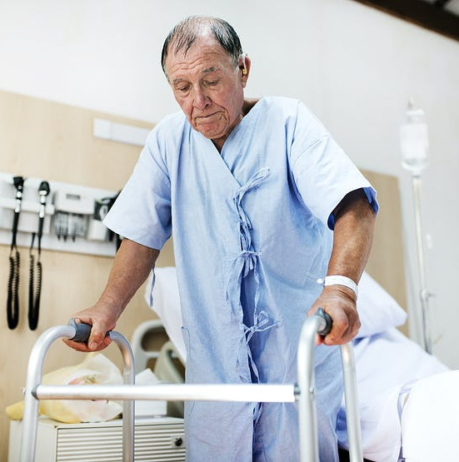
Think Vulnerable Populations:
Age: > 85 years old
Education: Teach Back Strategies
Assistive Devices within reach
Hip Protectors
Floor Mats
Height Adjustable Beds (low when resting only, raise up bed for transfer)
Safe Exit Side
Position Sensing Devices (Bed and BR)
Medication Review
Criteria for Surveillance

Slide 29

Bones: Fracture Risk/History
Hip Protectors
Height Adjustable Beds (low when resting only, raise up bed for transfer)
Floor Mats
Evaluation of Osteoporosis
Position Sensing Devices (Bed and BR)
Criteria for Surveillance

Slide 30

Bleeds/AntiCoagulation
Evaluate Use of Anticoagulation: Risk for DVT/Embolic Stroke or Fall-related Hemorrhage
Patient Education
TBI and Anticoagulation: Helmets
Wheelchair Users: Anti-tippers
Position Sensing Devices (Bed and BR)
Criteria for Surveillance

Slide 31
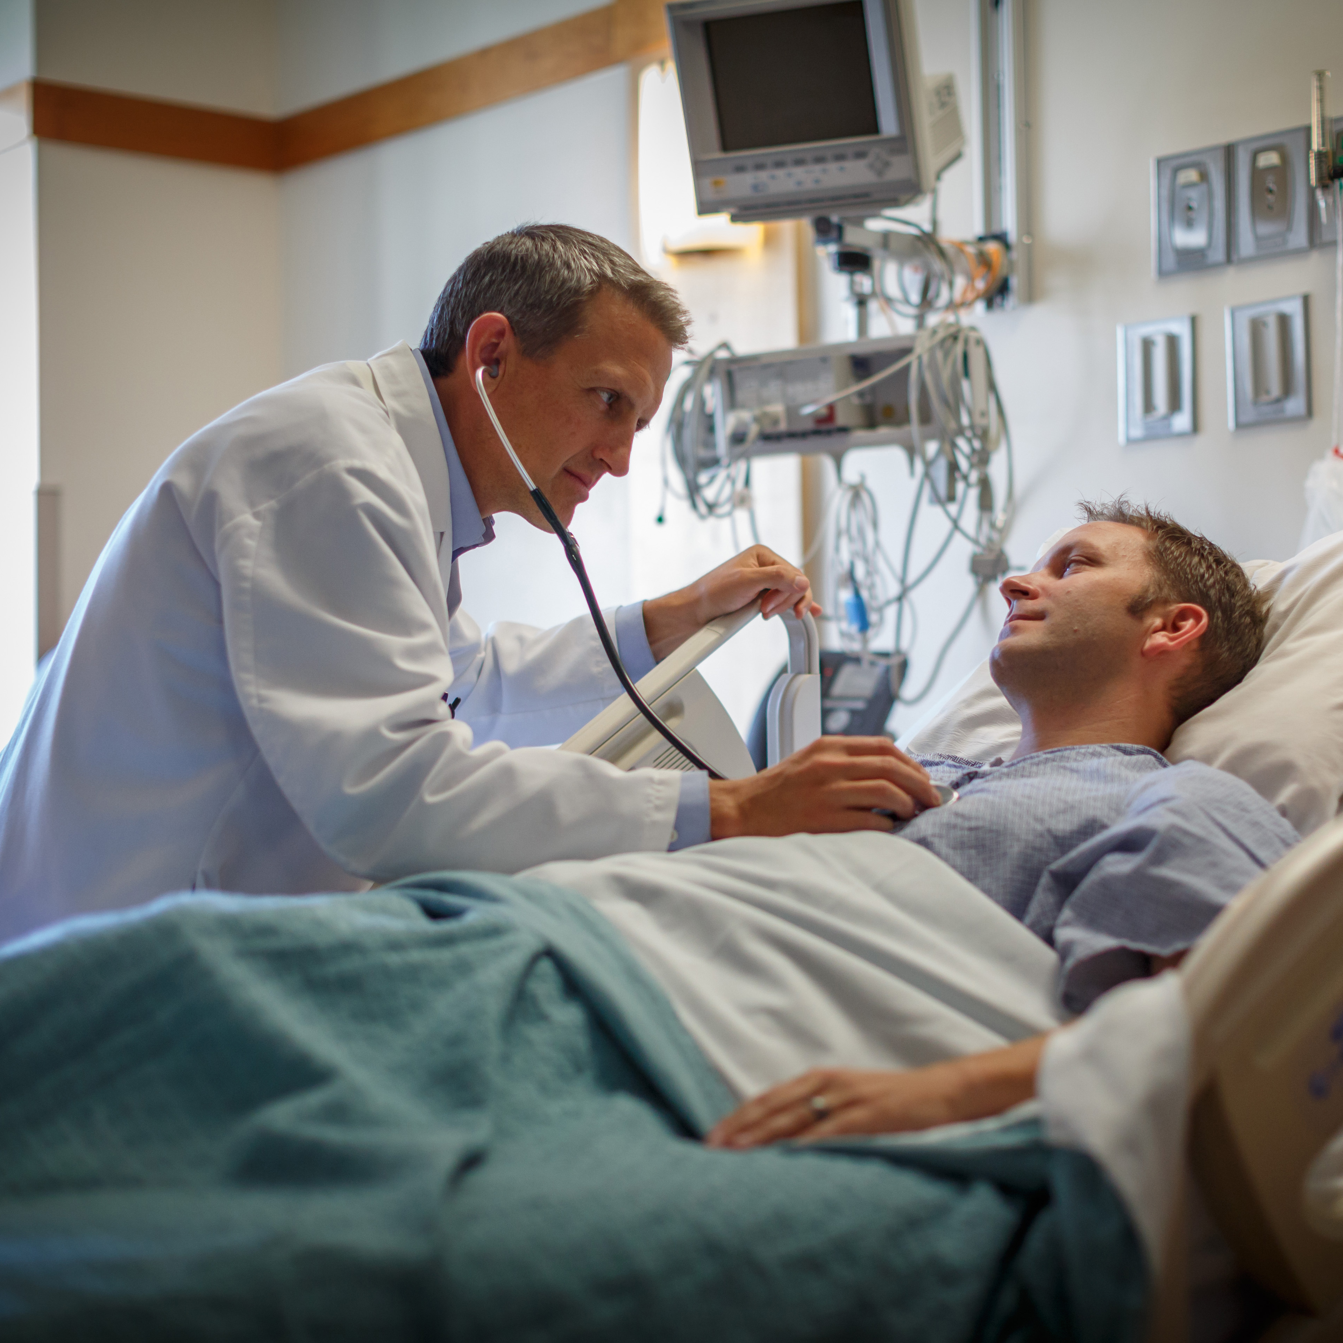
Surgical Patients
Pre-op Education (Call, Don’t Fall; Call Lights)
Post-op Education
Pain Medication:
  Offer elimination prior to pain medication
Orthostasis
Increase Frequency of Rounds
Position Sensing Devices (Bed and BR)
Criteria for Surveillance

Slide 32

Injury Protection
Floor Mats
Hip Protectors
Helmets
Eliminate Sharp Edges, esp. Bathrooms
Gait Belts (assisted fall)
Safe Exit Sides

Slide 33

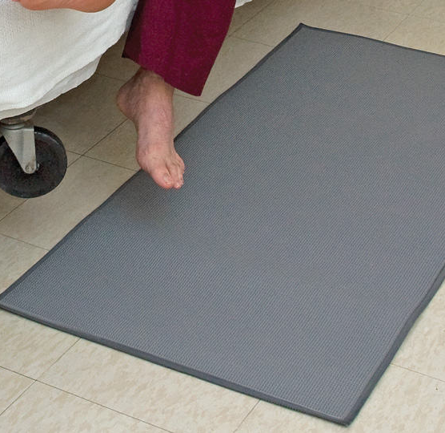
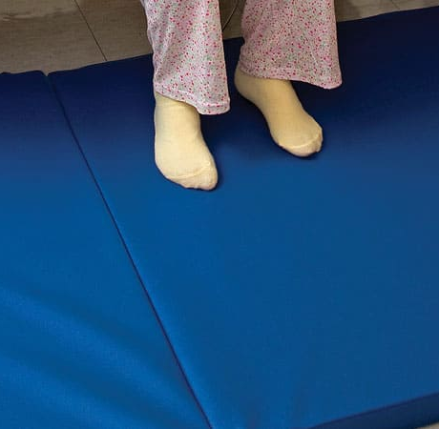
Bedside Mats/Fall Cushions
Bedside Fall Cushions
Floor Cushions
Floor Mat
Tri-Fold Bedside Mat
Roll-On Bedside Mat
Soft Fall bedside Mat

Slide 34

Rethink Program Analysis
How do you know your fall prevention program is working?
How do you measure success?
Think Structure and Processes!
Reduced Unassisted Bed/Chair/Toilet Exits?
Increased Assisted Bed / Chair / Toilet Exits?

Slide 35

Reengineer Your Falls Program
The best way to implement evidence-based practices, technology-based solutions is within the context of a well-designed program
A well-designed program promotes safe and reliable care, promotes vitality and teamwork, is patient-centered, and all processes are value-added

Slide 36

The Context for Program Design
“Reliability is the capability of a process, procedure, or health service to perform its intended function in the required time under existing conditions”
Vitality is a supportive environment with effective care teams continually striving for excellence
Patient-centered care honors the whole person and respects individual values and choices
Value-added care is free of waste and promotes continuous flow

Slide 37
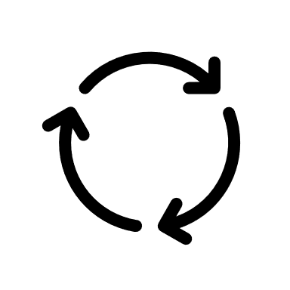
Successful Implementation and Adoption
Plan Implementation
PDSA Cycle
Track results of PDSA Cycle
Measure Structure and Process Changes – expand data specific to your safety net!

Slide 38


Organization Support
You have so much support!
Each Other
Your Hospital
Curbell Medical

Slide 39


Thank You
If you Fall Tell Someone

Slide 40

You Can Always Reach Me!
Patricia Quigley, PhD, MPH, ARNP, CRRN, FAAN, FAANP, FARN,
Nurse Consultant
pquigley1@tampabay.rr.com

