Slide 1


Fall Prevention Webinar Series
February 24th, 2021
Patricia Quigley
PhD, MPH, APRN, CRRN, FAAN, FAANP, FARN
Event sponsored by

Slide 2
Best Practices for Patient Toileting
By Dr. Patricia Quigley

Slide 3

Objectives
Profile trends of falls associated with toileting over the years
Examine patient and environmental fall risk factors that drives assessment.
Generate strategies to redesign a population-based approach for scheduled and assisted toileting while creating an environment for safe toileting.

Slide 4

Falls associated with toileting refer to:
The activities specific to navigating the physical environment to use the toilet
The physical act of elimination
The environment design of the bathroom
Staffing assistance
They are complex and interactive.
One of the top 10 patient safety concerns in hospitals (ECRI, 2014)

Slide 5

Early Findings: Where Falls Happen
Some 3-20 percent of inpatients fall at least once during their hospitalization.
Around 80-90% of falls that occur in hospitals are unwitnessed
About 50-70% occur from bed, bedside chair, or while transferring between the two, while 10-20% occur in toilets or bathrooms (a disproportionally large number given the short amount of time patients spend there).
(Inouye, et al, 2009; Oliver et al, 2010)

Slide 6

Prevalence of Inpatient Falls Associated with Toileting (2010, Tzeng)
Qualitative Study – Michigan Hospital
Archived falls over 3 year period; 4 inpatient units
547 falls July 2005-2008
45.2% of all falls related to toileting
Most common theme – falling on way from the bed or chair to the bathroom
Nurses: focus on safe pt transfers
Develop individualized prevention plan of care
Notes:
Tzeng, H-M. (2010). Understanding the prevalence of inpatient falls associated with toileting in adult acute care settings. JNCQ, 25(1): 22-30. doi: 10.1097/NCQ.0b013e3181afa321.

Slide 7
Toileting-related Inpatient Falls (2012, Tzeng & Yin)
Archived falls over 3 year period; 4 inpatient units
547 falls July 2005-2008
247 (45.2%) associated with toileting
87 (15.9%) on the way from bed or bedside chair to the bathroom or back
70 (12.8%) getting out of or back to bed
55 (10.1%) slipped off the toilet or bedside commode
27 (5.0%) moving from bed to BSC or back
8 (1.4%) using urinal while standing or sitting on edge of bed or chair
Notes:
Tzeng, H-M., Yin, C-Y. (2012). Toileting-related inpatient falls in adult acute care settings. MEDSURG Nursing, 21(6): 372 -377.
Retrospective exploratory study – 4 adult inpatient units

Slide 8
Toileting-related Falls at Night (2019, Rose, et al.)
Describe prevalence and characteristics of toileting-related falls in hospitalized older adults
Retrospective analysis of falls related to night-time toileting in patients 60 yoa and older over 1-yr period
34% of fall related to toileting with at least 44% occurring during the night
Peaked 11pm-1am, maximum supine-induced diuresis
About 50% of night falls occurred at bedside
Half had no strategies for toileting documented in care plan
Notes:
Rose, G., Decalf, V., Everaert, K., Bower, W. (2019, July 18). Toileting-related falls at night in hospitalized patients: The role of nocturia. Australasian Journal on Ageing, https://doi.org/10.1111/ajag.12696

Slide 9

Patient-specific fall risk factors
Patient‘s underlying fall risk factors
Problems with walking and transfers
Medication side effects
Confusion
Frequent toileting needs
Orthostatic hypotension
Balance and Mobility Issues

Slide 10

Patient Assessment
Cognitive Status – Judgement
Balance – Sitting, Standing
Ambulatory Status (level of assistance)
Assisted Mobility (Contact Guard vs Standby Assist)
Sensory Neuropathy
Continence
Orthostasis
(If falls due to intrinsic fall risk factors, Anticipated Physiological Falls)

Slide 11
Environmental Risk and Assessment
Low bed height
Safe exit side (bed transfer side),
Pathway to the bathroom,
Toilet access and placement
Low toilet height
Insufficient Grab Bars
Bedside Commode vs. Raised Toilet Seat
(If fall due to environmental extrinsic factors, is accidental fall)

Slide 12
Interaction Effect: Patient and Environment
Fall prevention involves:
Manage patient‘s underlying fall risk factors (e.g., problems with walking and transfers, medication side effects, confusion, frequent toileting needs) and
Optimize the hospital‘s physical design and environment (toilet height, grab bars, mobility devices). (Ganz, et al, 2013)
Maximize safe mobility
Individualize progressive toileting program

Slide 13
Consider the Balance to Maximize Toileting Safety
Autonomy vs. Safety
Privacy ?
Within Arm’s Reach ?
No One Toilets Alone ?

Slide 14

Context Matters
Environmental Design
Equipment Resources
Care Delivery
Communication Methods
Surveillance Methods
Staffing and Skill-mix
Available Technology

Slide 15
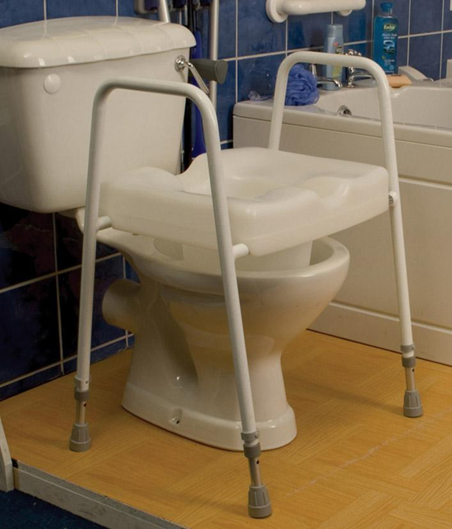
Why Not This?

Slide 16
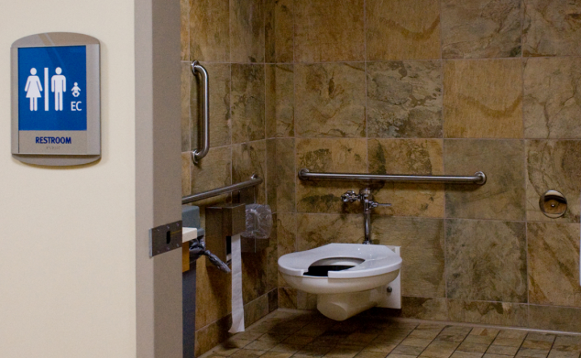
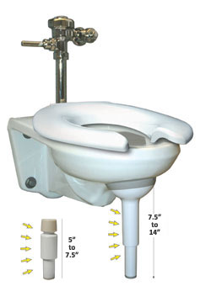
What’s the Matter with This?

Slide 17
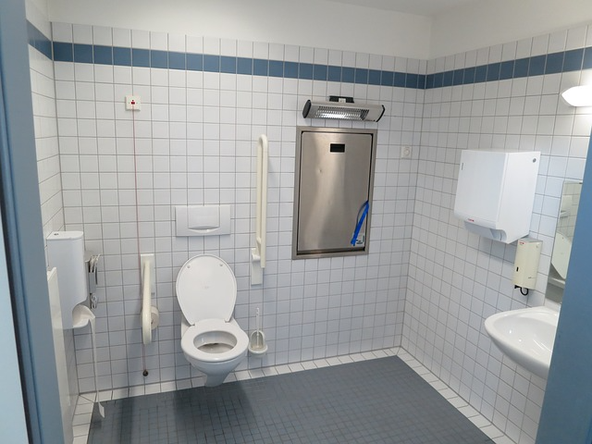
Redesigned for Patient Safety

Slide 18
Bathroom: SAFE DESIGN (2014)
Minnesota Hospital Association (MHA), the “Creating a Safe Environment to Prevent Toileting Related Falls Report” (2014)includes guidance for hospitals for creating a safer environment that supports patient safety while accessing and using the toilet.
https://www.mnhospitals.org/Portals/0/Documents/ptsafety/falls/CreatingASafeEnvironmenttoPreventToiletingRelatedFallsReport.pdf

Slide 19
MHA Journey: 2010-2014
Over the years of data review, 2010-2013, 40% of falls that resulted in serious harm or death involved toileting, including getting out of bed to go to the bathroom, falling on the way, or falling in the bathroom.
So SAFE from FALLS program further enhanced to reflect knowledge related to preventing toileting-related falls
Implemented practice strategies (within arms’ reach, hourly rounding, additional injury risk) impact leveled off
Notes:
Although a number of operational strategies were instituted to
prevent these types of falls from occurring, including: staying
within arms’ reach of high-risk patients even when in the
toilet room, hourly bed rounding, and additional fall injury risk
decreased but leveled off.
Therefore, MHA wanted a better
understanding of what environmental strategies could be
implemented to reduce patient falls during the toileting process.
Currently, the available resources that address environmental
impact on patient safety is generally limited to relevant building
codes and guidelines. All parties have recognized that the
building codes were developed to ensure consistency in
construction and not intended to address patient falls and safety
during the toileting process.

Slide 20
MHA Recommendations
Commissioned research project to better inform environmental factors and generate recommendations for safer bathrooms
Examples:
Grab Bars
Toilet Height
Line of Sight

Slide 21
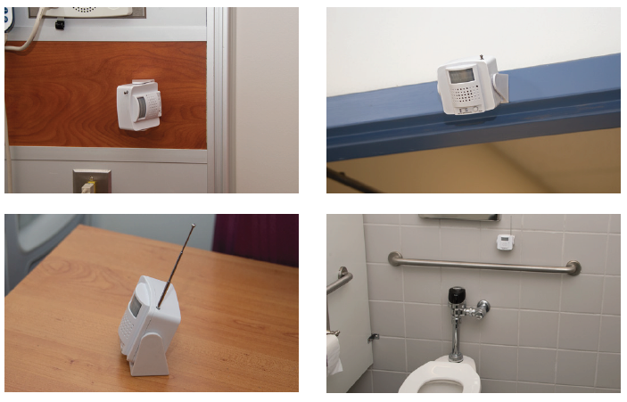
Curbell Toileting Solutions
Wireless Motion Sensor
  Will alarm to notify staff if the patient enters the toileting area unattended or can be position to be used when a patient is getting of the toilet without assistance
      Cordless solution
      Mounts to wall or can be set on a shelf
      Replaces traditional toilet seat sensors
      Aligned to Nurse Call Systems when paired with Curbell’s BC600 monitor
Notes:
MOTION SENSOR The CS-WMS Wireless Motion Sensor can be used as a standalone device or as an accessory for the BC600 Fall management monitor. When a patient passes through the detection area the CS-WMS will be triggered and will either alarm or send a wireless signal to the BC600 to alarm. The CS-WMS is cordless and can be placed on a night stand or be mounted on a wall.
TOILET SENSOR PAD This sensor mounts discreetly underneath the toilet seat so that a patient can be monitored by staff without a loss of privacy.

Slide 22
You Must!
Go Beyond Universal Approaches
Universal approaches to patient toileting programs fail to address the unique toileting needs of each patient.
Clinical practice standards require that nurses use clinical judgment to determine each patient’s specific toileting needs and schedule.
Utilize clinical expertise to maximize each patient’s functional ability to toilet and increase functional independence

Slide 23
Patient – Population Specific Toileting
Reconsider the value of a scheduled toileting protocol for each patient.
Discern which patient populations require a scheduled toileting retraining program and /or assistance for toileting
    stroke patients (right vs. left brain stroke patients)
    those with lower extremity weakness;
    frail elders on diuretics
Redesign a population-based approach
    post-op patients
    cognitively impaired vs. intact patients

Slide 24

Patient Characteristics
Cognitive Status
  Impaired
  Visual Neglect (to the left or right visual field)
  Confusion/Memory Deficits
Altered Bladder Continence
  Frequency, Urgency, Retention, Infection, Medications /Treatments [IVs, Diuretics]
Altered Bowel Continence Laxatives, Suppositories, Diarrhea, other
Mobility deficits
  General Weakness: (level of assistance: 1 or 2 person)
  Gait Deficits (Shuffling Gait, Foot Drop)
  Hemiparesis/Hemiplegia (left side or right side weakness)
  Balance deficits (Sitting, Standing)
Functional Level:
Dependent
Weight Bearing
Caregiver Assistance

Slide 25

Toileting: Dependent
Toileting slings with dependent lifts
    Larger access area
    Different selection criteria than standard dependent slings
Use of sit-stands for balance
Consider Caregiver access vs patient access

Slide 26
Toileting: Weight Bearing
Standing and raising aids
    Battery operated
    Non-battery operated
Considerations
    Assistance to stand
    Ability to access perineum for self hygiene
    Ability to manage clothing up and down
    Ability to get to and from the toilet

Slide 27
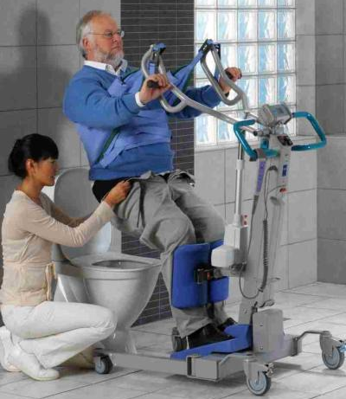
Toileting: Caregiver Assistance
Level of Assist (Min, Mod, Max – 1 vs 2 person)
Mobility Aides: Standing and raising aids: battery powered
  Lift provides support while caregiver can provide hygiene
  Some lifts allow patient to participate in hygiene
  Patient still gets weight bearing
  Patient can assist pulling to stand up some

Slide 28
Patient Perceptions: Not the Same as Ours
May be overwhelmed, distracted, unreceptive due to illness
Over-estimate abilities
Misunderstand and deny risk for fall
Must mobilize to go to the toilet
Want to be independent
May be unable to wait for assistance
Want privacy (Sonnad, et al., 2014)
Fall prevention strategies find for others, but not for me (Haines, 2014)
Don’t worry about falls like we do!
Notes:
Sonnad, et al, 2014 found that patient perception of falls risk did not match their clinical risk or actual experience and they may overestimate the ability of the care team to prevent falls.
Haines 2014 found that 25-34% of elderly patients age 70 years or greater thought a falls prevention strategy was fine for someone else but not needed for me

Slide 29

Next Steps…..
What is universal? All care must be individualized! That includes toileting… bathroom safety
Select 2-3 ideas for change
Use Small Tests of Change
Implement with commitment to succeed
Keep track of your journey

Slide 30
  I hope this helps!

Slide 31
References
ECRI Institute’s Top 10 Patient Safety Concerns for Healthcare Organizations. 2014. Plymouth Meeting, PA: Publisher.. available online at https://www.ecri.org/2014hazards
Ganz, D.A., Huang, C., Saliba, D., Shier, V., Berlowitz, D., Lukas, C.V., et al. (Jan. 2013). Preventing Falls in Hospitals: A Toolkit for Improving Quality of Care. Rockville, MD: Agency for Healthcare Research and Quality. AHRQ Publication No. 13-0015-EF.
Haines, T.P., Day, L., Hill, K.D., Clemson, L., Finch, C. 2014. Better for others than for me: a belief that should shape our efforts to promote participation in falls prevention strategies. Archives Gerontology Geriatrics. 59, 136-44.

Slide 32
References
Hitcho, E.B., Krauss, M.J., Birge, S., Dunagam, W.C., Fischer, I., Johnson, S., Nast, P.A., Costantinou, E., & Fraser, V.J. (2004). Characteristics and circumstances of falls in a hospital setting. Journal of General Internal Medicine, 19(7), 732-739.
Inouye SK, Brown CJ, Tinetti, ME. Perspective: Medicare, nonpayment, hospital falls and unintended consequences. N Engl J Med. 2009 Jun 4;360(23):2390-3. DOI: 10.1056/NEJMp0900963

Slide 33
References
Minnesota Hospital Association, the “Creating a Safe Environment to Prevent Toileting Related Falls Report” (2014)includes guidance for hospitals for creating a safer environment that supports patient safety while accessing and using the toilet.
  https://www.mnhospitals.org/Portals/0/Documents/ptsafety/falls/CreatingASafeEnvironmenttoPreventToiletingRelatedFallsReport.pd

Slide 34
References
Rose, G., Decalf, V., Everaert, K., Bower, W. (2019, July 18). Toileting-related falls at night in hospitalized patients: The role of nocturia. Australasian Journal on Ageing, https://doi.org/10.1111/ajag.12696
Sonnad. S.S.., Mascioli, S., Cunningham, J., & Goldsack, J. (2014). Do patients accurately perceive their fall risks? Nursing. 44(11): 58-62.

Slide 35
References
Tzeng, H-M. (2010). Understanding the prevalence of inpatient falls associated with toileting in adult acute care settings. JNCQ, 25(1): 22-30. doi: 10.1097/NCQ.0b013e3181afa321.
Tzeng, H-M. (2010). Understanding the prevalence of inpatient falls associated with toileting in adult acute care settings. JNCQ, 25(1): 22-30. doi: 10.1097/NCQ.0b013e3181afa321.

