Slide 1


Strategies to Maximize Safe and Assisted Bed Exits
By Dr. Patricia Quigley
PhD, MPH, APRN, CRRN, FAAN, FAANP, FARN, Nurse Consultant
Email: pquigley1@tampabay.rr.com

Slide 2
My Goals
Challenge and Inspire you to add precision to your patient safety practices, safe mobility and fall prevention clinical practices to maximize safe and assisted bed exits and reduce bed-related falls.
Change your practice beyond an over-reliance on universal approaches and a fall-risk score for safe bed-mobility and exit.

Slide 3
Objectives: Safe and Assisted Bed Exits
Understand and manage risk of unassisted bed exits
Prioritize bed exit interventions into safe mobility and fall prevention care planning
Explore options to redesign and individualize the patient’s room and create safe exit sides
Integrate innovative technology to facilitate assisted bed exits
Commit to Engage Patients as Partners in Care

Slide 4


But First, What We Know:
Some Patients WILL Get Out of Bed Without You
Patients’ Perceptions about Falls Differ from Yours
Not All Falls are Equal
Falls from Beds result in Injury!
Universal Fall Prevention Bundles are not effective
”Non-compliance” is overused
Bed Alarms can be repurposed
Falls are not just a nursing issue

Slide 5

Facts – What We Know from the Evidence
Sitters don’t prevent falls (4 of 5 falls that occurred with a sitter present were unassisted; Feil & Wallace, 2014)
Evidence to support intentional rounding is weak, feasibility for sustainability is uncertain (LeLaurin & Shorr, 2019)
System-based interventions work: Toileting (i.e. wake em, take em; timed toileting; assist in and out of bed) (Resnick & Boltz, 2019)
Notes:
Feil, M., & Wallace, S. (2014, Mar. 6). The use of patient sitters to reduce falls: Best practices. Pennsylvania Patient Safety Advisory. https://www.researchgate.net/publication/266022031_The_Use_of_Patient_Sitters_to_Reduce_Falls_Best_Practices/citation/download

Slide 6
Over Reliance on Call Lights as Strategy: Alert and Cognitively Impaired Patients
The average call light response time across four hospitals was 13 mins and 18 secs.
3 hospitals: avg response time range 3 mins. 7 secs to 3 mins. 10 secs
1 hospital: longest avg responsive time 17 mins 27 secs
Must Read:
BMC Health Services Research| Article number: 84 | March 31, 2012 | The contribution of staff call light response time to fall and injurious fall rates: an exploratory study in four US hospitals using archived hospital data | Huey-Ming Tzeng, PhD, MS, FAAN | Marita G Titler PhD, RN, FAAN David L Ronis, PhD |Chang-Yi Yin, MA

Slide 7

Understanding and Managing Risk
Understand, manage and reduce risk
Associated with patient, the bed, and the interaction within organizations.
Who is NOT at Risk for getting out of bed unassisted?
Risk Adjustment

Slide 8

Accident Theory
Hazards
Losses
Notes:
MANY DEFENSIVE LAYERS RELY ON PEOPLE, PROCEDURES OR PROTOCOLS TO STOP HAZARD FROM HARMING PT-ALL HAVE HOLES-OPEN AND CLOSE – MOMENTARILY ALIGN ALLOWING HAZRDS TO HARM PT

Slide 9


SPHM: Patient Handling Injury
Barriers to prevent injury
Patient and Staff Injury
Patient loses balance while sitting on edge of the bed
Staff skills and equipment to manage loss of balance
Float Nurse pulled to Med/Surgical Care area
Inadequate assessment of the bed to meet the patient’s needs
SPHM Assessment of Patient not completed according to Policy
Notes:
First Slice – Structures and Processes to determine risks – Patient Abilities and Disabilities to transfer and ambulate, height adjust the environment
Second Slice - Environmental Factors not individualized – height adjusted chairs / toilets
Third Slice - Staff use manual patient assist
Example: 75 yo, obese, 6ft 2’’ Male with chronic LBP, sp left knee replacement, ambulate with 2 wheeled rolling walker to bathroom to use toilet, toilet is too low, insufficient grab bars – tries to descend onto toilet and loses balance – assisted fall…

Slide 10

Fall Event: Fall Risks
Fall Risk Factors
Fall & Injury
Patient sits up in bed and falls from bed
Dementia, unable to use call light
Universal Fall Precautions
Patient has agitation and impulsivity
Fall Risk Screening Tool used, not assessment of bed mobility
Notes:
First Slice – Structures and processes are screening – not assessment
Second Slice – Patient’s intrinsic and extrinsic fall risk factors
Environmental Factors – not individualized to the patient – Walker not within reach
Example: 65 yo female, mild memory deficits, shuffling gait, walked with a 2 wheeled walker at home, admitted with CHF, on a diuretic and walker is not placed at her bedside … she gets OOB to go to the BR, you apply non-skid socks, and she tries to walk over to get her walker, falls and breaks a hip

Slide 11


Manage and Reduce Risk
Patient: Screening is NOT the same as Assessment
Environment: Infrastructure and Capacity must be enhanced
Interaction between both PT and Environment: Consider Cognitive and Mobility Function and the Environment
Context Matters:
Culture, Leadership, Varying levels of Clinical Expertise and Judgment and Patient Autonomy

Slide 12

Falls From Beds Result in Injury
Understanding the
“rate of splat” and its
impact on injury

Slide 13
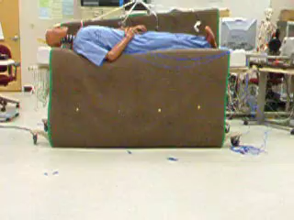
Falls from High Bed: Head First

Slide 14
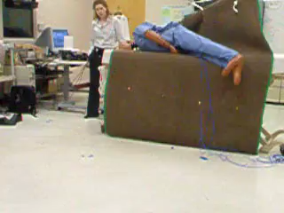
Falls from High Bed: Foot First

Slide 15
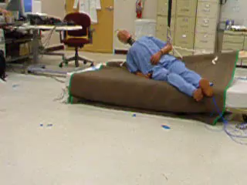
Foot First Low Bed Fall

Slide 16

Prioritize bed exit interventions into safe mobility and fall prevention care planning
Patient Assessment - Bed Mobility
Bed / Mattress Assessment
Safe Exit Side
Individual Adjusted Bed Height
Assisted Transfer Technology
Position Change Alarms

Slide 17
Patient Assessment: Bed Mobility Tasks
Roll from Side To Side
Reposition Self in Bed
Support Self on Elbow
Bend Knees
Supine to Sitting
Sitting to Supine
Move legs over the side of the bed
Lift legs back into the bed

Slide 18
SPHM Algorithms: Traditional Suggested Care Pathway
Start Here
Can
patient
bear
weight?
Caregiver assistance not
Needed; Stand by for safety
as needed.
Fully
No
Partially
Stand and pivot technique
using a gait/transfer belt
(1 caregiver) or powered
standing assist lift
(1 caregiver).
Is the patient cooperative?
Yes
Is the patient cooperative?
No
Yes
Use full body sling
Lift and 2
Caregivers.
Does the patient have upper extremity strength?
No
For sealed transfer aid, must have chair with arms that recess or are removable
For full body sling lift, select a lift that was specifically designed to access a patient from the car (if the car is starting or ending destination).
If patient has partial weight bearing capacity, transfer toward stronger side.
Toileting slings are available for toileting.
Mesh slings are available for bathing.
During any patient transferring task, if any caregiver is required to lift more than 35lbs. of a patient’s weight then the patient should be considered to be fully dependent and assistive devices should be used for the transfer
Seated transfer aid; may use
gait /transfer belt until the
Patient is proficient in
completing transfer
Independently.
Yes
Notes:
Algorithms are not prescriptive, so clinical judgment is a must!

Slide 19

VISN 8 PSCI, 2005, Safe Patient Handling and Movement Algorithms
Transfer To and From: Bed to Chair, Chair to Toilet, Chair to Chair, or Car to Chair
1
Lateral Transfer To and From: Bed to Stretcher, Trolley
2
Transfer To and From: Chair to Stretcher, Chair to Chair, or Chair to Exam Table
3
Reposition in Bed: Side to Side, Up in Bed
4
Reposition in Chair: Wheelchair or Dependency Chair
5
Transfer a Patient Up from the Floor
6
https://www.lmcins.com/uploads/3/2/0/7/3207324/safe_patient_handling.pdf

Slide 20

Transfer Approach and Equipment
Stand Pivot Transfer – 1 vs 2 person assist
Dependent on Weight-Bearing Status
Gait Belts
Slide Boards
Lifts

Slide 21


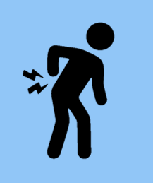
Ergonomic exposures associated with Caregiver-Assisted activities of daily living (ADLs)
So Many Ways for Injury To Occur
Bending
Static Postures
Twisting
Have to use
SPHM Equipment
to prevent injury
Slippery floors
Lifting
High Forces
Crouching
High Repetition
Reaching

Slide 22

Regular vs Concave Mattresses

Slide 23


Redesign the Room:
Bed Placement in Room
Notes:
https://www.google.com/search?q=free+pictures+of+hospital+beds&rlz=1C5CHFA_enUS732US732&sxsrf=ALeKk03pM8JRYWYR1RoVlzRoBTXpLXSymg:1615991204497&tbm=isch&source=iu&ictx=1&fir=aDe_4eMoX5JqbM%252Crcdo05bYm_PJPM%252C_&vet=1&usg=AI4_-kSTbPsquCD32p7Zmc6Ti-2-QR835w&sa=X&ved=2ahUKEwjN3NCtxLfvAhWASjABHd17DHYQ9QF6BAgHEAE&biw=946&bih=557#imgrc=aDe_4eMoX5JqbM

Slide 24

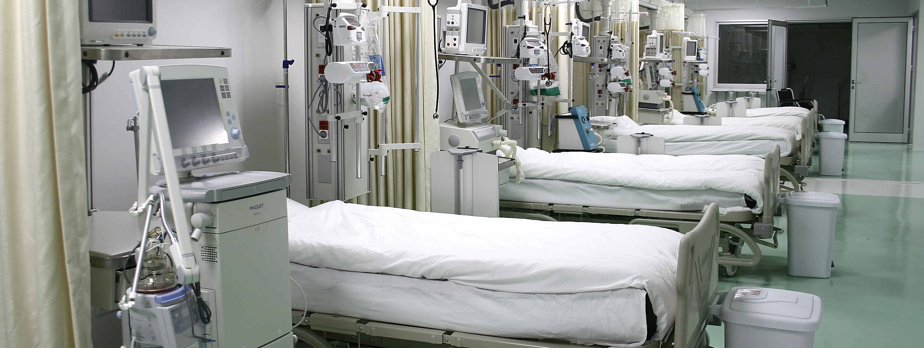
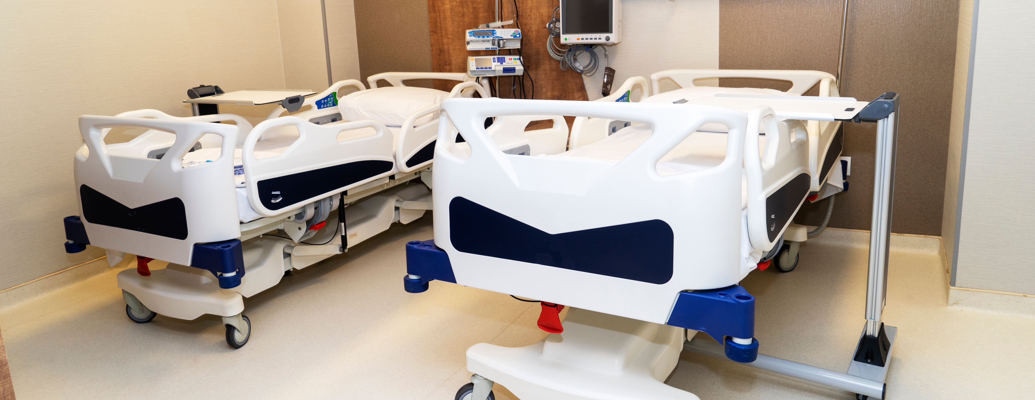

Manage and Individualize the Environment
Notes:
https://www.google.com/search?q=free+pictures+of+hospital+beds&rlz=1C5CHFA_enUS732US732&sxsrf=ALeKk024oxjfg5IYo7A1sG_cYCR8FqSZCw:1615986305415&tbm=isch&source=iu&ictx=1&fir=aDe_4eMoX5JqbM%252Crcdo05bYm_PJPM%252C_&vet=1&usg=AI4_-kSTbPsquCD32p7Zmc6Ti-2-QR835w&sa=X&ved=2ahUKEwj1sMiNsrfvAhXqzVkKHSr4CkcQ9QF6BAgKEAE&biw=946&bih=557#imgrc=aDe_4eMoX5JqbM

Slide 25
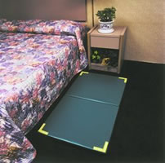
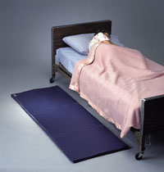
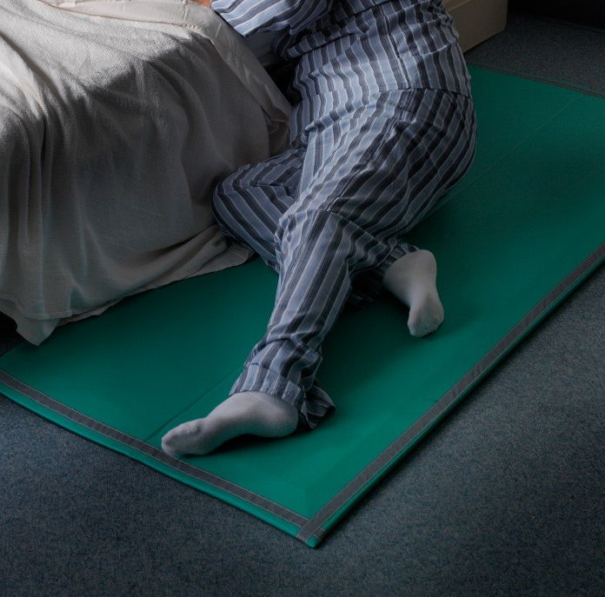
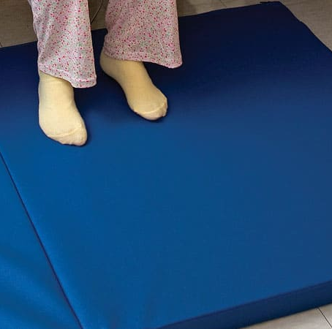
Safe Exit Sides and
Reduce Harm

Slide 26
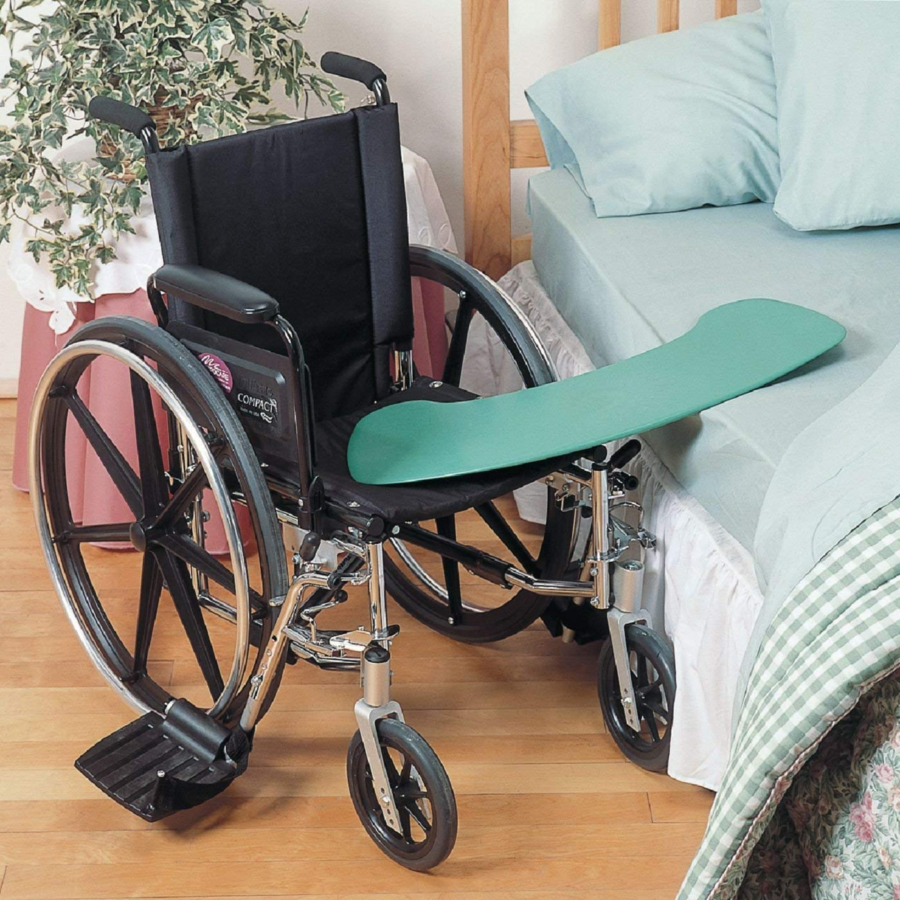

Slide Boards Transfers

Slide 27
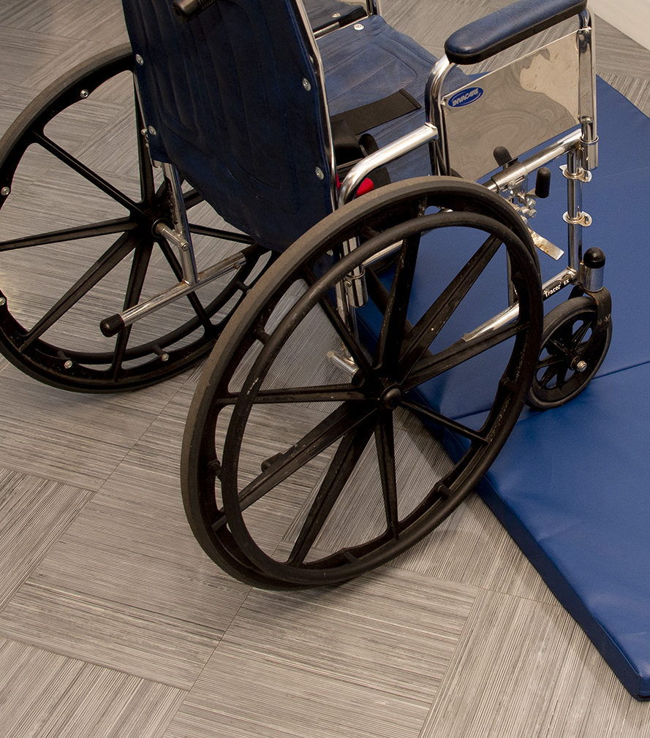
What’s the matter with this?

Slide 28

Apply This To Practice
Chronic Low Back Pain Patients
Post Op Patients
New Mothers who Just Delivered
Stroke Patients – which side of the bed is the safe exit side? Let’s practice!

Slide 29

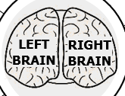
Hemispheric Functions
Numbers
Colors
Synthesis
Logic
Analysis
Imagination
3D
Lines
Daydreaming
Lists
Rhythm
Words

Slide 30
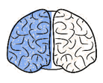
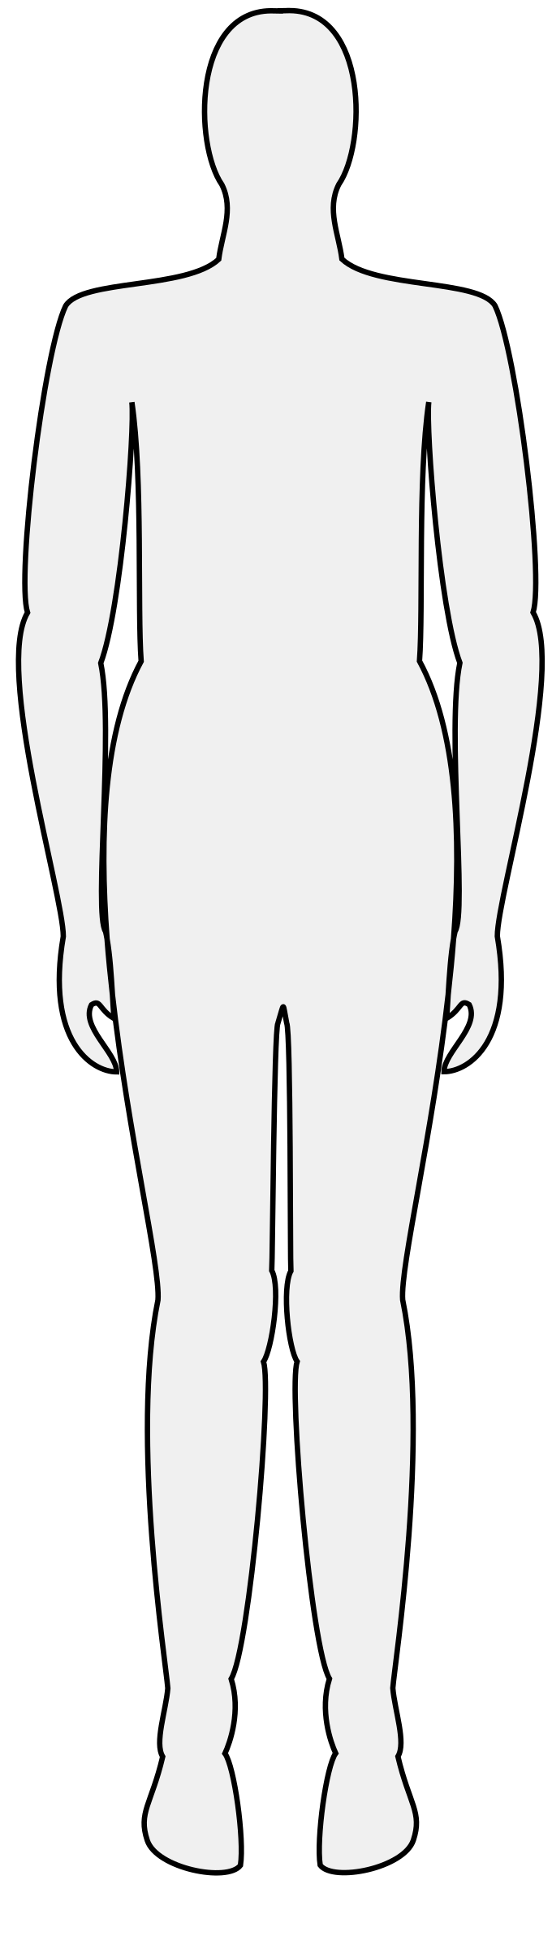
Lateral Characteristics
Right Brain Damage
Left Brain Damage
Paralyzed
Right Side
Paralyzed
Left Side
Speech/Language Deficits
Spatial/Perceptual Deficits
Behavioral
Style: Slow,
Cautious
Behavioral
Style: Quick, Impulsive
Memory Deficits
(Language)
Memory Deficits
(Performance)

Slide 31

General Deficits
Left Brain CVA
Right Brain CVA
Visual deficits to the right
Right sided weakness
Speech and language deficits
Has slow and cautious behavior
Emotionally labile
Motor planning problems
Right visual field deficits
Left hemiparesis
Impulsivity
Safety awareness deficits
Spatial impairment
Sensory loss

Slide 32

Safe Exit Strategies
Who is at greatest risk for exiting the
bed unassisted?
Who is at greater risk for falls?
Which bed placement in the room (A or B)

Slide 33

Reengineer Protocols
Mobility Protocols
  Contact Guard Assist
  Standby Assist
  Assistive Devices
  Verbal Cues/Reinforcement
Re-engineer Sitter Programs to Mobility Aides
Set Up Balancing Measure – Staff Injuries vs. Assisted Fall

Slide 34





Bed Sensors Pads: See Curbell Medical Products at the end of this presentation
Corded bed sensor pads are a good choice when you need a simple sensor for your monitor.
Cordless bed sensor pads eliminate cord tripping hazards and cord damage — the primary cause of false and failed alarms, and replacement/repair costs.
Short-Term bed sensor pads are for single patient use sensor pads and are disposable.
Long-Term bed sensor pads are durable, long-lasting and can be cleaned and reused between patients

Slide 35

Integrate Technology
Combine Call Lights with Teach Back
Repurpose Bed Alarms to Position Change Alarms
Strategize Staff Response
Script Message to Patient: Reminder to Wait for a Nurse
Must Read:
White Paper - Prepared for Curbell Medical, Inc. | Re-purposed Alarm Use for Residents in Nursing Homes: Nurse Response and Patient Fall Management Program | Patricia Quigley, PhD, MPH, APRN, CRRN, FAAN, FAANP, FARN

Slide 36


Patient Education Videos
SIKANA, a non-profit organization whose aim is to equip people with practical skills through free education video programs, in partnership with the SIEL Blue Group Association, also a non profit organization, developed over 50 free exercise videos to improve the health of older and adults living with chronic diseases. https://www.sikana.tv/en/sport/50-gym-exercises-for-seniors#chapter-5_
Click here for video link

Slide 37
Transferring In and Out of Bed
The first video, Good Everyday Habits: Getting Out of Bed, guides older adults in step-by-step body mechanics to get into bed safely with special focus on reducing risk of falls: https://www.sikana.tv/en/sport/50-gym-exercises-for-seniors/how-to-get-out-of-bed
Click here for video link

Slide 38
Lying Down In Bed
A second video, Good Everyday Habits: Lying Down in Bed, instructs older adults in step-by-step body mechanics to approach a bed, side and recline on the bed with special focus on reducing fall risk: https://www.sikana.tv/en/sport/50-gym-exercises-for-seniors/how-to-lie-on-a-bed
Click here for video link

Slide 39

Patient Engagement
Crucial Conversations
Tendency to Over-estimate Abilities
Balance Safety with Autonomy
Use Teach Back

Slide 40

Life is Rich with Opportunities
The Evidence supports Opportunities to enhance safe mobility and fall and fall with injury prevention program infrastructure
What will you do to Change Practice?
That’s
Implementation Science
Focus on Risk Factors
Focus on Preventing Injury
Learn from Adverse Events - Falls and Injuries
Partner with Patients and Family Members
Strategies included in Long Presentation

Slide 41

Product Info & References
Strategies to Maximize Safe and Assisted Bed Exits
May 19th, 2021
The following slides contain the information and links referenced throughout this webinar. Please feel free to reach out to us with any questions about the information or the products.
greamsnyder@curbellmedical.com

Slide 42
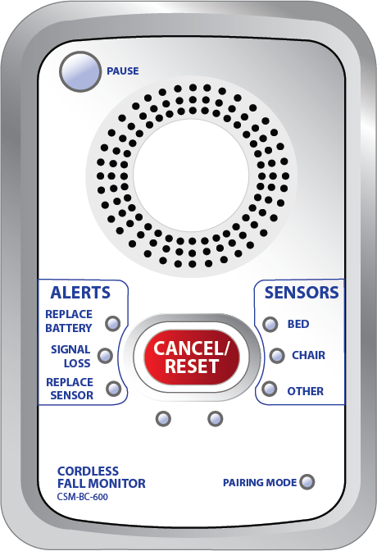


Curbell Medical
PAUSE gives the caregiver 60 seconds
to remove the patient from the sensor
without causing an alarm.
BC600 Cordless/Corded FM Monitor
Clinician Input Design! Simple to understand and easy to use for caregiver day to day use:
Clearly labeled, easy to read buttons and LED indicator lights
Setup functions kept out of sight in battery compartment
      Delay control* 
      Tone switch
Volume
Nurse call jack allows direct notification to nurse call
Silent option when connected to Nurse Call 
Can be used with both cordless and corded sensors
60 Second Alarm Pause* 
Can control up to three cordless devices at the same time
3 AA Batteries - 6 Month Battery Lifespan
SENSORS identify which
sensor initiated the alarm.
*Reduces False Alarms
Reduces Alarm Fatigue
CANCEL/RESET flashes when an
alarm is triggered making it more
noticeable for the caregiver
ALERTS show when to replace the
batteries or sensor pad and if there
is a lost signal.
Click here for more product information

Slide 43
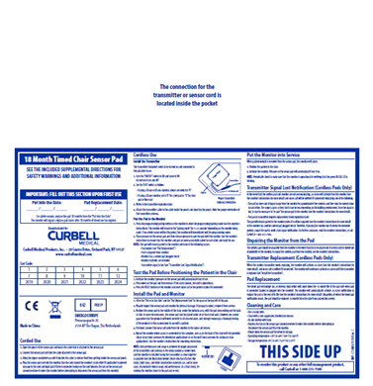
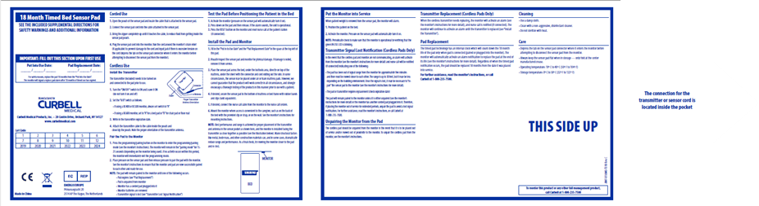
Curbell Medical
Zippered pouch VS. Velcro, addresses biohazard concerns
18-Month Corded & Cordless Sensor Pads
The 18-month lifespan is the longest in the market and is an economical solution to short-term sensor pads:
Interchangeable – can be used as a corded or cordless solution with a switch to either a cable (corded) or transmitter (cordless)
  Corded Sensor Pad* - allows for quick easy setup and use
  Cordless Sensor Pad - option eliminate cord tripping hazards and cord damage
Self Auditing - eliminates need for staff to manually track when the sensor needs to be replaced.
  Eliminates possibility of expired sensors being used with a patient
Pad sizes – bed sensor pad 10”x30”, chair sensor pads 10”x15”
 Additional accessories (cables and 18-month transmitters) can be purchased separately
* Corded sensor pad part numbers include the cable
 Cordless sensor pads include the 18-month transmitter
FOLDABLE SEAM on the bed sensor pads only allow for easy storage
Click here for more product information

Slide 44
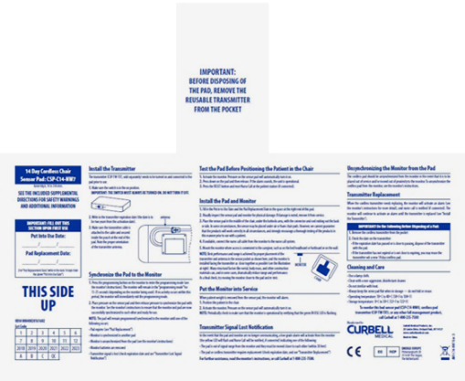
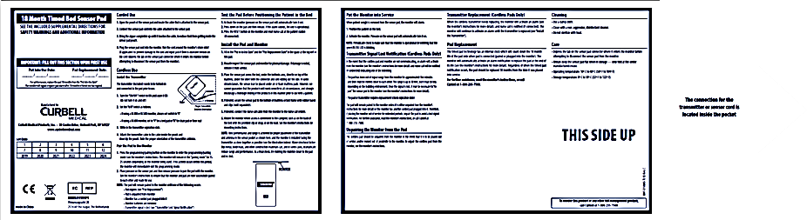
Curbell Medical
Chair Pad 7”x 15”
Short Term Corded & Cordless Sensor Pads
Single patient use sensor pads are an ideal solution when infection control is a concern:
Available in two styles:
  Corded Sensor Pad* - allows for quick easy setup and use
  Cordless Sensor Pad  - option eliminate cord tripping hazards and cord damage
Disposable – throw away after patient use.
Good up to 30 Days of use on a single patient
Smaller chair pad sizes allow for more immediate alarm notification if the patient shifts out of normal position
Bed Pad 3” x 30”
 Short term sensor pad must be used with the CSP-TW-TX45DY 90 Day Disposable Transmitter (sold separately)
* Corded sensor pad have an attached, fixed cable but a cable extension is available and sold separately
Click here for more product information

Slide 45
Curbell Medical
ANTENNA to improve signal strength
CS-WMS Wireless Motion Sensor
SENSORS identify motion sensor’s status
Provides reliable infrared motion detection in light and dark conditions. It can be used as a standalone device or as an accessory for the BC600 fall management monitor. When a patient passes through the detection area, the CS-WMS will be triggered and will either sound an alarm or send a wireless signal to the BC600 to alarm:
STATUS
Can be mounted on a wall above bed, chair, doorway or above a toilet
Compatible with BC600 cordless monitors
  Can send an alert through nurse call when paired with the BC600
Narrow detection angle with adjustable distance
Stand alone option
3 AA Batteries - 6 Month Battery Lifespan
ALARM/OFF/TRANSMIT
RESET/
PAUSE
RESET/PAUSE cancels alarm or pauses from triggering 15 seconds.
TRANSMIT MODE when switched to, a signal is sent to a BC600 monitor, which is connected to the nurse call system to provide an alarm at the nurse’s station.
ALARM MODE when switched to, the Wireless Motion Sensor will sound an audible alarm when motion is detected.
Click here for more product information

Slide 46





Curbell Medical – Other FM Products
Floor Mats
Seat Belts
Toilet Sensor
Wander Management
Accessories
Other FM Monitors
Placed near beds, chairs, and doorways to alert staff if a patient attempts to stand or walk. Available in corded and cordless options.
In addition to setting off an alarm when unfastened, it also helps keep the patient from sliding down the wheelchair.
Mounts discreetly underneath the toilet seat so that a patient can be monitored by staff without a loss of privacy.
Door strip sensor mounts near a doorway and will alarm when a patient worn wristband sensor nears the sensor strip
Mounts, clips, cables, replacement parts, transmitters and nurse call adaptors
Curbell has a selection of FM monitors to meet the need and budget of the facility; pull-string monitors, simple and advance corded only monitors.
Click here for more product information

Slide 47

References
Barbara Resnick, PhD, CRNP | Marie Boltz, PhD, CRNP
Clinics in Geriatric Medicine | Volume 35, Issue 2, P237–251, May 01, 2019 | Optimizing Function and Physical Activity in Hospitalized Older Adults to Prevent Functional Decline and Falls
Jennifer H. LeLaurin, MPH | Ronald I. Shorr, MD,MS
Clinics in Geriatric Medicine | Volume 35, Issue 2, P273-283, May 01, 2019 | Preventing Falls in Hospitalized Patients: State of the Science

Slide 48
References
Michelle Feil, MSN, RN | Susan C. Wallace, MPH, CPHRM
Pennsylvania Patient Safety Advisory| Volume 11, No. 1, March 2014| The use of patient sitters to reduce falls: Best practices
David Oliver, MD, FRCP | Frances Healey, RN, BSc | Terry P Haines, PhD
Clinics in Geriatric Medicine | Volume 26, Issue 4, P645-692, Nov 01, 2019 | Falls and Fall-Related Injuries in Hospitals

Slide 49
Bed Height – Read:
Marissa Christman | Janice Morse PhD | Chris Wilson | Nate Godfrey | Alexa Doig PhD, RN | Donald Bloswick PhD | Andrew Merryweather PhD
Procedia Manufacturing | Volume 3, P280-287, 2015 | Analysis of the influence of hospital bed height on kinematic parameters associated with patient falls during egress.
Pierre Gervais PhD | Janice Morse PhD | Charlotte Pooler PhD, RN | Alexa Doig PhD, RN| Donald Bloswick PhD | Andrew Merryweather PhD
Global Qualitative Nursing Research| doi:10.1177/2333393615575321, April 27, 2015 | The Safety of hospital beds: Ingress, egress, and in-bed mobility.

Slide 50
Call Light – Read:
Huey-Ming Tzeng, PhD, MS, FAAN | Marita G Titler PhD, RN, FAAN
David L Ronis, PhD |Chang-Yi Yin, MA
BMC Health Services Research| Article number: 84 | March 31, 2012 | The contribution of staff call light response time to fall and injurious fall rates: an exploratory study in four US hospitals using archived hospital data

Slide 51
White Paper – Read:
Patricia Quigley, PhD, MPH, APRN, CRRN, FAAN, FAANP, FARN
White Paper - Prepared for Curbell Medical, Inc. | Re-purposed Alarm Use for Residents in Nursing Homes: Nurse Response and Patient Fall Management Program

Slide 52


Links:
Safe Patient Handling and Movement Algorithms
Curbell BC600 Cordless Bed and Chair Monitor Info Sheet
Curbell Motion Sensor Info Sheet
Curbell Fall Management Products Catalog
Curbell Fall Management Education
Sikana.tv: 50 Gym Exercises for Seniors Videos
Sikana.tv: Transferring In and Out of Bed
Sikana.tv: Lying Down In Bed

Slide 53

Contacts:
greamsnyder@curbellmedical.com
rdavoli@curbellmedical.com
pquigley1@tampabay.rr.com

Slide 54

See you next time!
Next Webinar
Wednesday, September 22nd 2021
- National Fall Prevention Day -
“Post FM Guide to Analyzing Falls and Prevention Action”
Presented by Dr Patricia Quigley
35 minutes

Slide 55


Thank You and Please Share More!
Thank you for attending, be a Champion for Change, and keep me posted – I am here for you!
Patricia Quigley, PhD, MPH, ARNP, CRRN, FAAN, FAANP, FARN, Nurse Consultant
pquigley1@tampabay.rr.com

