Slide 1


Fall Prevention Special Focus: Emergency Departments
Nov. 17, 2021
Patricia Quigley
PhD, MPH, ARNP, CRRN, FAAN, FAANP, FARN
Event sponsored by

Slide 2

Fall Prevention and Management Innovative Solutions for Emergency Departments
By Dr. Patricia Quigley
PhD, MPH, ARNP, CRRN, FAAN, FAANP, FARN

Slide 3
My Goals:
Challenge and Inspire you to implement innovative technology and fall care planning management into Emergency Departments’ fall and injury reduction practices.
Affirm our Moral Imperative to reduce fall risks through individualized fall prevention management to promote patients’ function, independence and safety.

Slide 4
Objectives:
Update Burden of Falls on Emergency Departments and Hospitalizations
Elevate the prominence of Emergency Departments within the continuum of care as a critical point of care for fall prevention.
Introduce an innovative solution to create a safe environment to reduce falls from stretchers
Showcase an innovative fall management solution for known fallers vs at risk for falls patients who are either admitted for acute care or discharged home.

Slide 5
The Burden of Falls is Great
CDC’s Updated analysis of 2019 unintentional injury deaths, which again includes death due to falls, was the third leading cause of unintended injury death for the entire US population.

Slide 6
By Age Group, Unintentional Injuries by all ages, gender and race.
By age group, unintentional injury death was the
3rd leading cause of death in infants < 1 year of age;
1st leading cause of death in age groups 1-4, 5-9, 10-14, 15-24, 25-34, 35-44;
3rd leading cause of death in age groups 45-54, 55-64; and, 7th leading cause of death in older adults >65 and older.

Slide 7
Loss of Life
However, falls was the leading reason for unintentional injury death for older adults. Out of a total of 60,257 unintentional injury deaths, the leading cause is falls, 56.5% of all causes of unintentional injury death.

Slide 8
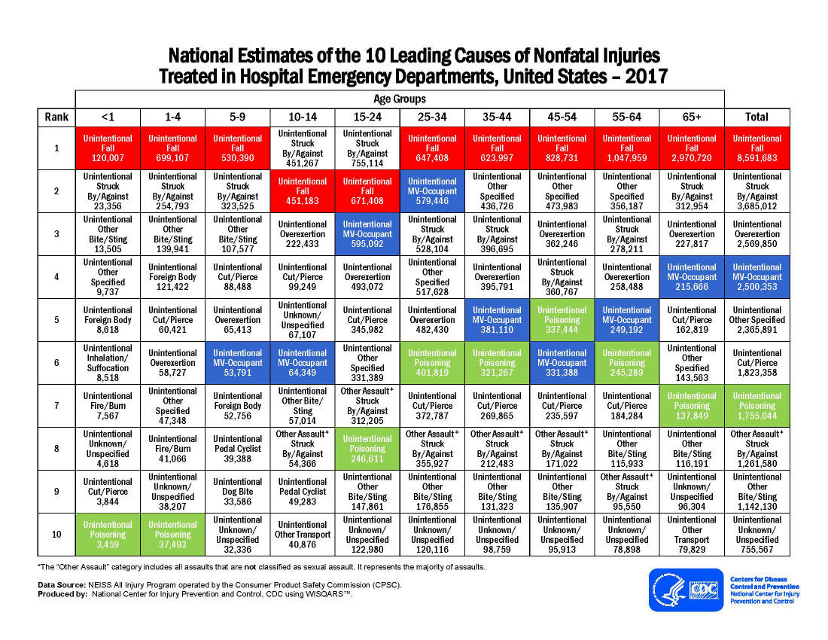
Notes:
Latest Data reported by CDC: 2017
https://www.cdc.gov/injury/images/lc-charts/leading_causes_of_nonfatal_injury_2017_1100w850h.jpg
Accessed Oct. 20, 2021

Slide 9
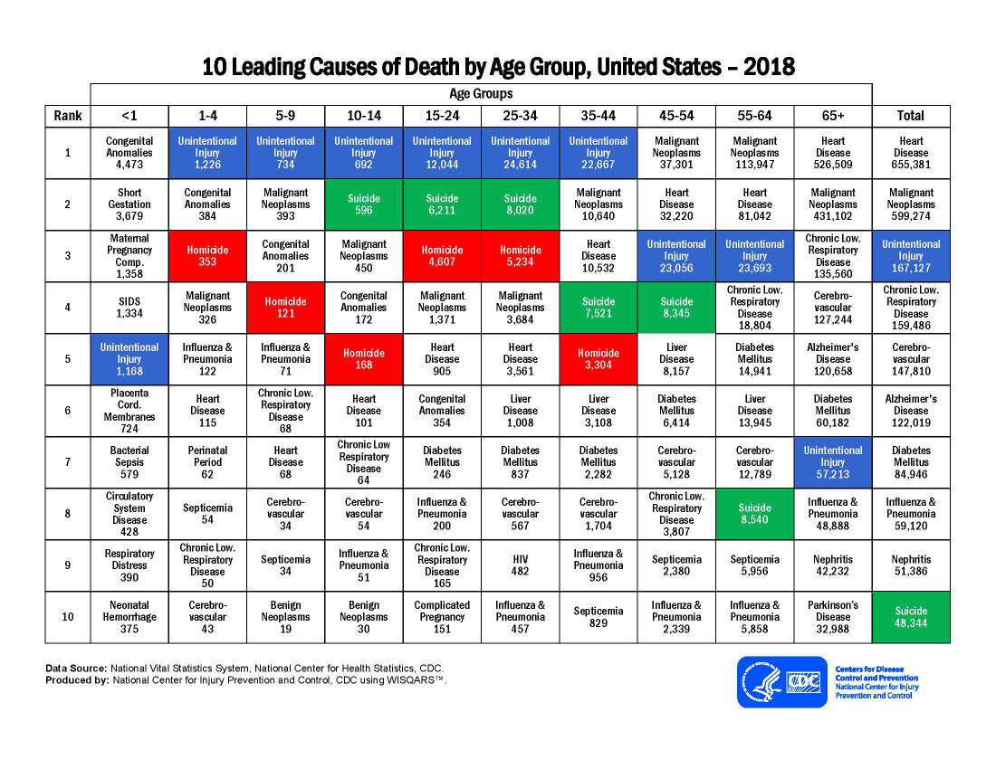
Notes:
10 leading causes of death by age group.
https://www.cdc.gov/injury/images/lc-charts/leading_causes_of_death_by_age_group_2018_1100w850h.jpg
Unintentional injury deaths

Slide 10
Every Day, Minute, Second Counts
Every year, approximately 3.7 million Americans turn 65. According to Factora, et al., (2021), older adults ages 65 years and older are twice as likely to fall than younger adults (OR 2.84 [1.77-4.53]). So, we are going to focus on older adults
Every year, more than 1 in 4 older adults falls, but more than half of those who fall don’t tell their healthcare provider.

Slide 11
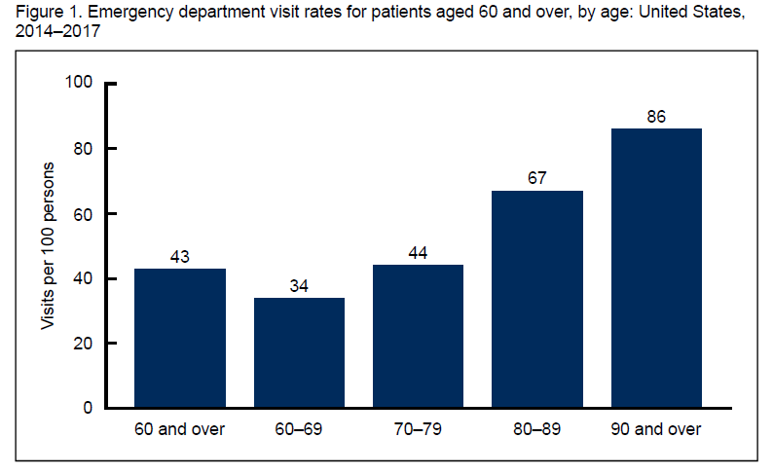
Older Adults by Age Groups
The ED visit rate increased with age for persons aged 60 and over.
Must Read:
Emergency Department Visits Among Adults Aged 60 and Over: United States, 2014–2017 |Products - Data Briefs - Number 367 - June 2020 (cdc.gov) |Jill J. Ashman, Ph.D., Susan M. Schappert, M.A., and Loredana Santo, M.D., M.P.H.
Notes:
Data from the National Hospital Ambulatory Medical Care Survey Key Findings:
In 2014–2017, the emergency department (ED) visit rate for persons aged 60 and over was 43 visits per 100 persons aged 60 and over and increased with age, from 34 visits per 100 persons aged 60–69 to 86 visits per 100 persons aged 90 and over.
About 7% of ED visits among patients aged 60 and over were made by nursing home residents, and this percentage increased with age.
About 30% of patients aged 60 and over who visited the ED arrived by ambulance, and this percentage increased with age.
The percentage of ED visits among patients aged 60 and over due to unintentional falls increased with age.
Nearly one-quarter of ED visits among patients aged 60 and over resulted in a hospital admission, and this percentage increased with age.
In the United States, the number of older adults is increasing. From 2007 to 2017, the number of adults aged 60 and over increased from 52 million to 71 million, and during the same time period, the share of the U.S. population comprising older adults also increased from 17% to 22% (1,2). During 2014–2017, 20% of all emergency department (ED) visits in the United States were made by patients aged 60 and over, representing an annual average of approximately 29 million ED visits (3–6). Given their growing proportion of the population, older individuals will make up an increasingly larger share of ED visits in the coming years. This report describes ED visits made by adults aged 60 and over, assessing selected characteristics by age.

Slide 12
Every Second an Older Adult Falls
36M
FALLS
8M
INJURIES
3M
ED VISITS
950K
HOSPITALIZATIONS
32K
DEATHS
https://www.cdc.gov/steadi/provider-training/index.html
Notes:
In 2018, In the United States, about one in four adults (28%) age 65 and older, report falling each year. This results in about 36 million falls each year. While not all falls result in an injury, about 37% of those who fall reported an injury that required medical treatment or restricted their activity for at least one day, resulting in an estimated 8 million fall injuries¹
^{32% hospitalized – 950K}

Slide 13
Growing Burden
73M
PEOPLE
52M
PEOPLE
52M
FALLS
TOTAL OLDER ADULTS
TOTAL OLDER ADULTS
36M
FALLS
12M
INJURIES
8M
INJURIES
2018
2030
https://www.cdc.gov/steadi/provider-training/index.html
Notes:
2018: out of 8 mil injuries, 3 million (.375%) are admitted to the ED,
32% hospitalized:
2030: out of 12 mil injuries, about 5 mi in the ER, and think about hospitalizations

Slide 14
Falls are Costly
$50 Billion
TOTAL MEDICAL COSTS EACH YEAR, FOR OLDER ADULT FALLS IN THE UNITED STATES
https://www.cdc.gov/steadi/provider-training/index.html
Notes:
STEADI—Older Adult Fall Prevention’
STEADI: Empowering Healthcare Providers to Reduce Fall Risk
https://www.cdc.gov/steadi/provider-training/index.html

Slide 15
ER Burden
Every 11 seconds, an older person visits the ER due to a fall (National Council on Aging [NCOA, 2021). Every 20 minutes in the United States, an older adult dies from a fall (CDC STEADI, 2020).
https://www.cdc.gov/steadi/provider-training/index.html

Slide 16
Falls and Fall-Related Injuries in Hospitals
Best Practice Approach in Hospitals:
  Implementation of safer environment of care for the whole patient cohort (flooring, lighting, observation, threats to mobilizing, signposting, personal aids and possessions, furniture, footwear)
  Identification of specific modifiable fall risk factors
  Implementation of interventions targeting those risk factors so as to prevent falls
  Interventions to reduce risk of injury to those people who do fall
Hospital Falls: D. Oliver, et al. Falls and fall-related injuries in hospitals. (2010, Nov). Clinics in Geriatric Medicine.
(Oliver, et al., 2010, p. 685)

Slide 17


Create a Safe Environment: Solutions
Stretcher Safety
Bathroom Safety
Injury Prevention

Slide 18

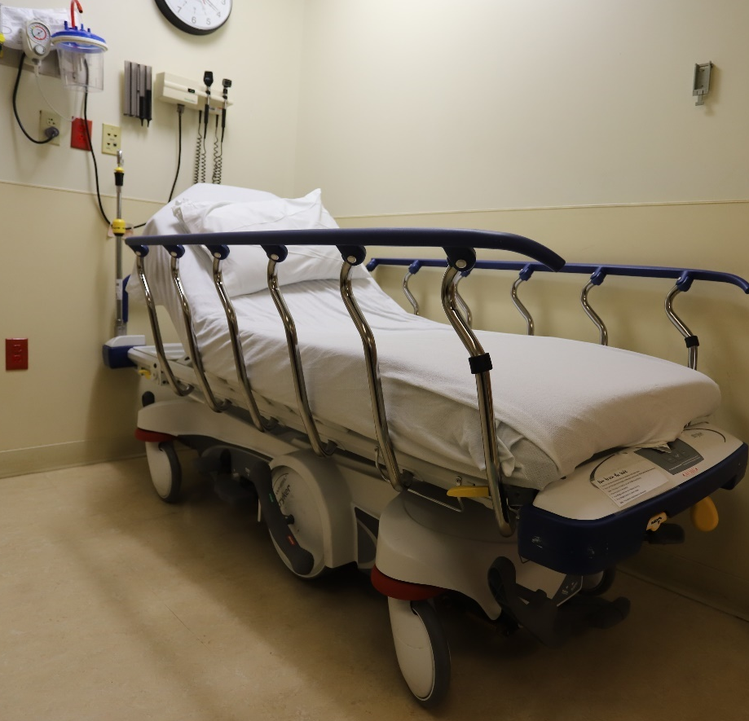
Fall Management Trial – Overview
May 6-Sept 13, 2021
Location: 60 bed facility in Central New York • Emergency and Trauma Services; 18 bays and 21 stretchers
Goal: The focus is to find out the effectiveness of implantation of position change sensors and alarms to stretchers, to reduce falls and fall injuries in the Emergency Department.
6 monitors plus a supply of disposable sensor pads were provided to the facility. ED staff elected to place monitors on stretcher side rails using the plastic strap provided by Curbell Medical
Products Used:
  CSM-BC600 • Curbell Fall Management Monitor
  CSP-B14-NC4 • 4”x30” Corded Bed Sensor Pads

Slide 19
Background and Product Setup
Current Fall Management Practices in ED
Currently use other sensor monitors in the ED
Staff has experienced challenges using the a fall risk assessment tool
  Risk assessments are often left incomplete by staff.
  Patients are sometimes evaluated incorrectly as a risk assessment
Patients assessed as a fall risk may not always be monitored with a sensor pad.
  Staff may not be able to timely locate the sensor pad to use on a fall risk patient
  Sometimes it is forgotten by staff, to use the sensor pad on a at risk patient
Believed their fall rate percentage has increased along with patient population and increased responsibilities due to COVID 19

Slide 20
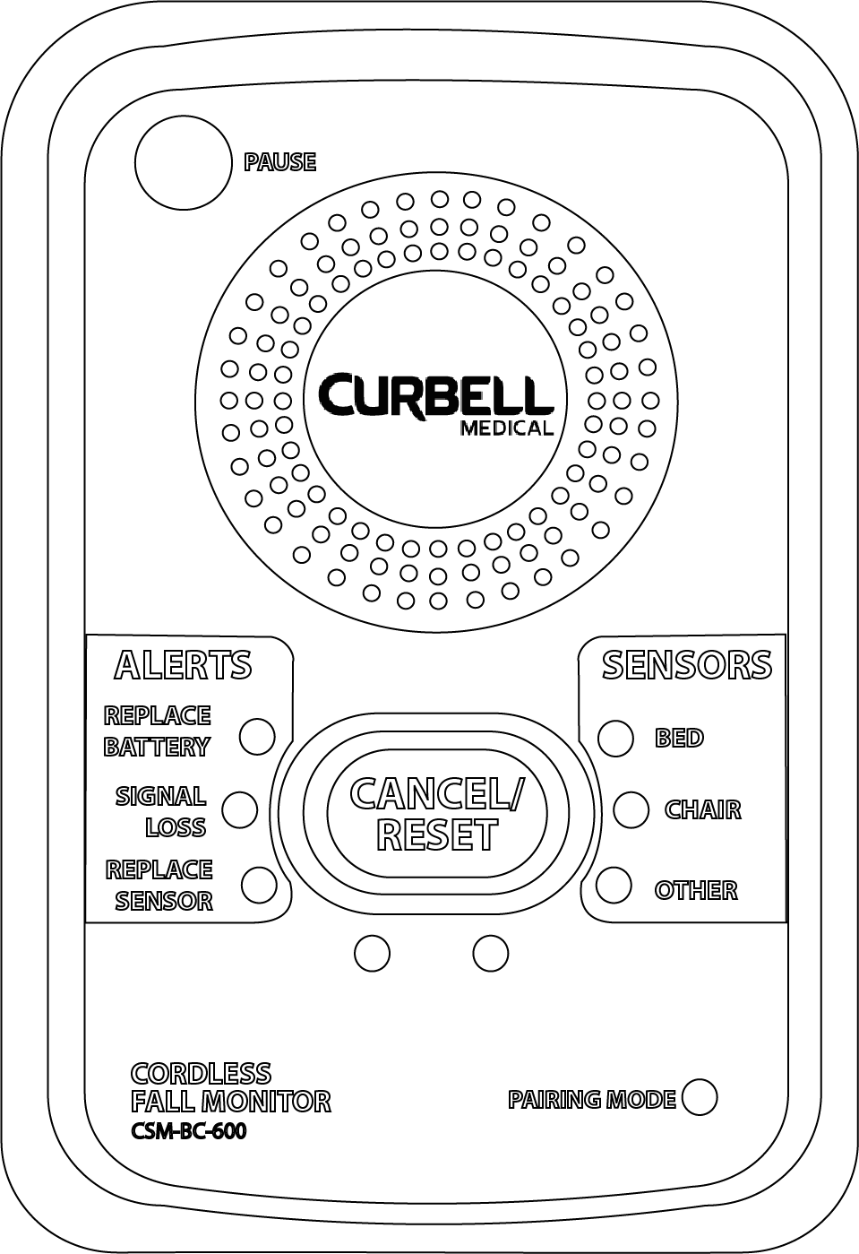



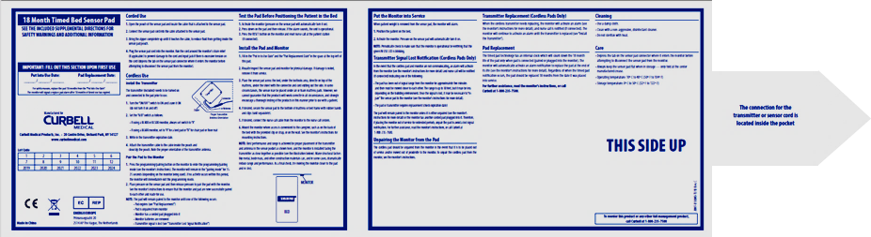
Curbell Medical - Bed Exit Solution for Stretcher
Sensor Pad
Monitor
Nurse Call
Signal Nursing
A Sensor Pad is placed on the stretcher (under the patient) and is connected to the Monitor
The Monitor would be alarm when pressure is removed from the sensor pad
The Monitor would be connected directly to the Nurse Call with a ¼” nurse call cable.
When the Monitor alarms, a notification will be sent through nurse call*.
*The BC600 has the ability to do “silent monitoring” and will only send notification through nurse call without the alarm going off in the room

Slide 21
Safe Mobility in the ER
Audible Alert Plus Nurse Call Notification
Audible Alert
Exam Room
Hallway
Monitor
Nurse Call
Monitor
Corded Chair Sensor Pad or Seat Belt
Corded Sensor Pad
Corded Sensor Pad
Monitor
Notes:
Exam Room
When Nurse call is available the bed exit solution can be plugged into the nurse call system
Hallway
Monitors give an audible alert when a patient leaves a chair or stretcher

Slide 22
Initial Feedback on Curbell Medical Monitor and Pads
Like the BC600 Fall monitor, especially the ability to pause the monitor to allow for the patient to be removed from the pad without causing an alarm
Initial concern with the size of the sensor pad (4” compared to the 10” pad they have used in the past) but no real issue
Like the idea of placing the sensor pad under the patient’s shoulder blades to allow for an early detection
Like disposable pads

Slide 23

Final Feedback
Fall Reduction
While no clear answer was given when asked if the Curbell Medical fall management devices reduced falls in the ED, feedback on this question was directionally positive.
  ED staff agreed the devices worked, “the alarms went off”, as evidence the system was operating as intended.
  One participant mentioned the system was effective notifying them of unanticipated patient bed exits

Slide 24
Final Feedback
Asked if would like to have fall management systems available on all stretchers, most enthusiastically agreed they would.
Availability of easy to use fall management devices on all ED stretchers would make it more likely that all patients would get monitored for falls.

Slide 25

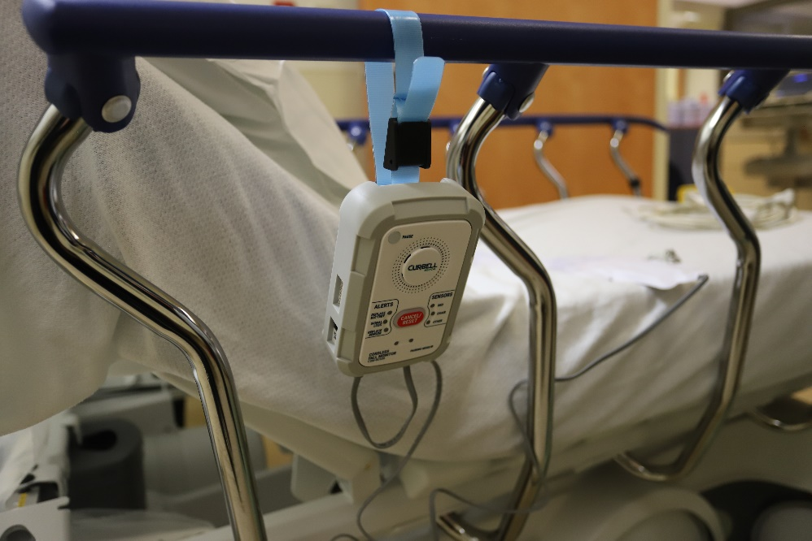
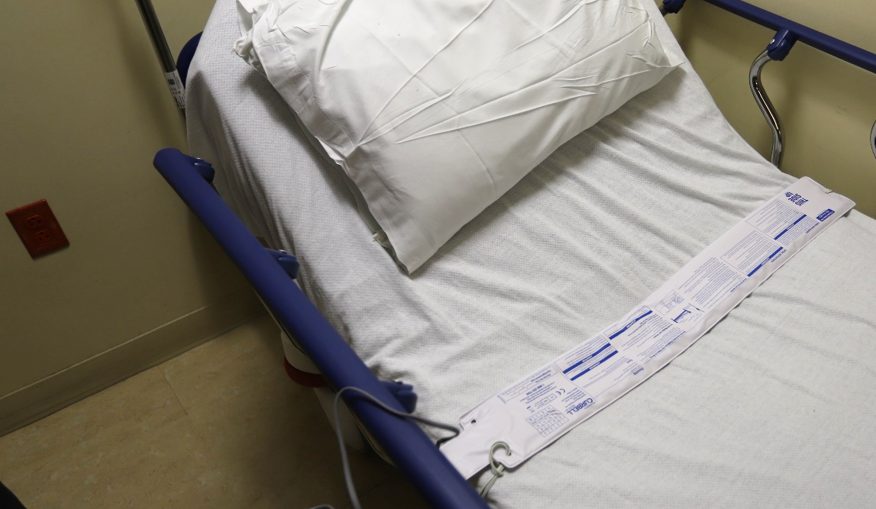
Best Practice for using Solution
Every stretcher should be equipped with a position alert monitor
Monitor should always stay with the stretcher
Having the equipment readily available on the stretcher makes it more likely to be used.
Notes:
Best Practice
The monitor should remain ON and the pause function should be used to remove the patient from the surface to avoid false alarms
The monitor should always stay with the stretcher.
Shown in the image the monitor is attached with a nylon strap to the stretcher rail but aluminum mounting stretcher brackets are also available.
The sensor pad should be placed on the stretcher before the patient
If adding the sensor pad after the patient, it required two people to place the pad under a patient already on a stretcher (patient may need to be rolled from side to side), making it less likely the pads would be used
Moving the sensor pad under the patient’s shoulder blades to allow for an early detection warning
Short term sensor pads
Disposable – replaced after patient use.
Long term sensor pads
Reusable
Must be cleaned between patients
Some stretcher pads allow the use of the sensor pad under the stretcher cover and would not need to be cleaned between patients.
The pad is placed inside the cover between the foam and the cover
If it is corded bring the cord out through the zipper opening
Pad will always be with the stretcher and ready to use

Slide 26
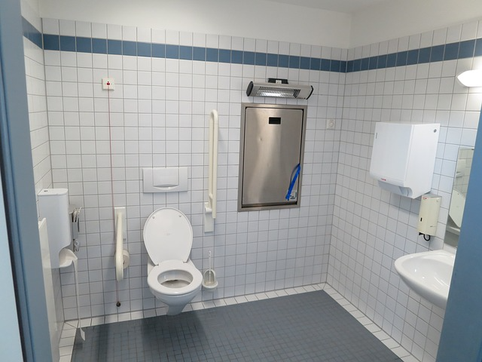
Redesigned for Patient Safety

Slide 27
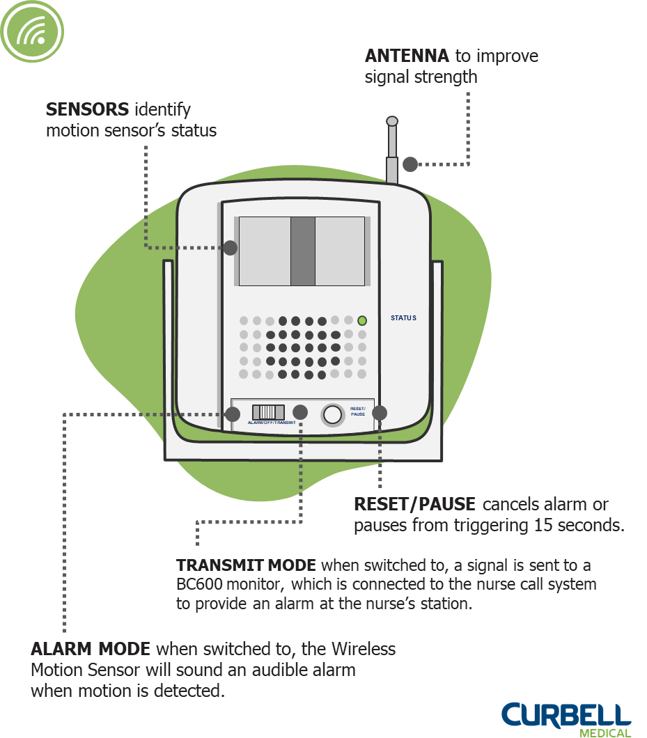
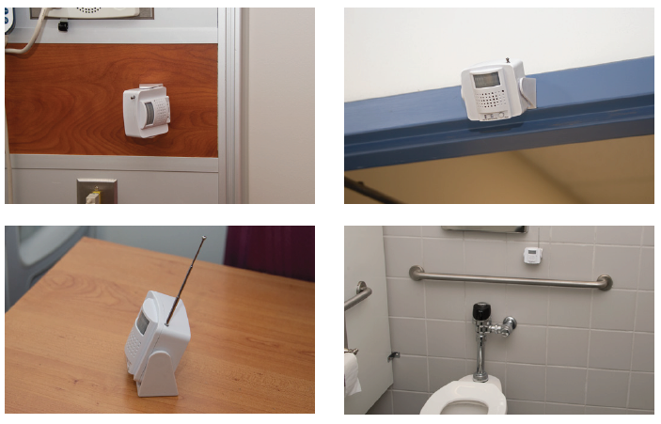
Curbell Toileting Solutions
Wireless Motion Sensor
  Will alarm to notify staff if the patient enters the toileting area unattended or can be position to be used when a patient is getting of the toilet without assistance.
      Cordless solution
      Mounts to wall or can be set on a shelf
      Replaces traditional toilet seat sensors
      Aligned to Nurse Call Systems when paired with Curbell’s BC600 monitor
Notes:
MOTION SENSOR The CS-WMS Wireless Motion Sensor can be used as a standalone device or as an accessory for the BC600 Fall management monitor that connects into nurse call systems. When a patient passes through the detection area the CS-WMS will be triggered and will either alarm or send a wireless signal to the BC600 to alarm. The CS-WMS is cordless and can be placed on a night stand or be mounted on a wall.
TOILET SENSOR PAD This sensor mounts discreetly underneath the toilet seat so that a patient can be monitored by staff without a loss of privacy.

Slide 28
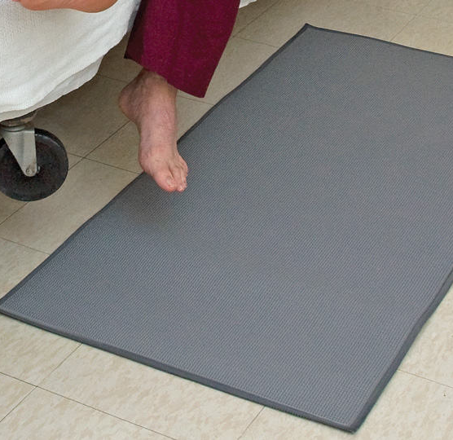
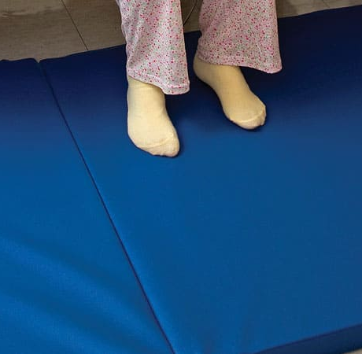
Bedside Mats/Fall Cushions
Bedside Fall Cushions
Floor Sensor Cushions
Floor Sensor Mat
Tri-Fold Bedside Mat
Roll-On Bedside Mat
Soft Fall bedside Mat
HD Nursing
  New Innovative Floor Mat
  SenseAi
https://www.hdnursing.com/

Slide 29

We Share the Same Goals
Create an environment for all, engage our patients/residents and caregivers as partners in care, and
Preserve and advance each person’s function and safety: Individualized Fall Prevention Care Management Across the Care Continuum

Slide 30
Fall Risk Screening and Assessment
Every Older Adults who enters the ED should have a Fall Care Plan Started:
Screen – History
Assessment
Functional Assessment (for those who can, when stable and at appropriate level of care)
Introduce you to Safe Balance
SAFE BALANCE® Technology | Safe Balance (safe-balance.com)

Slide 31
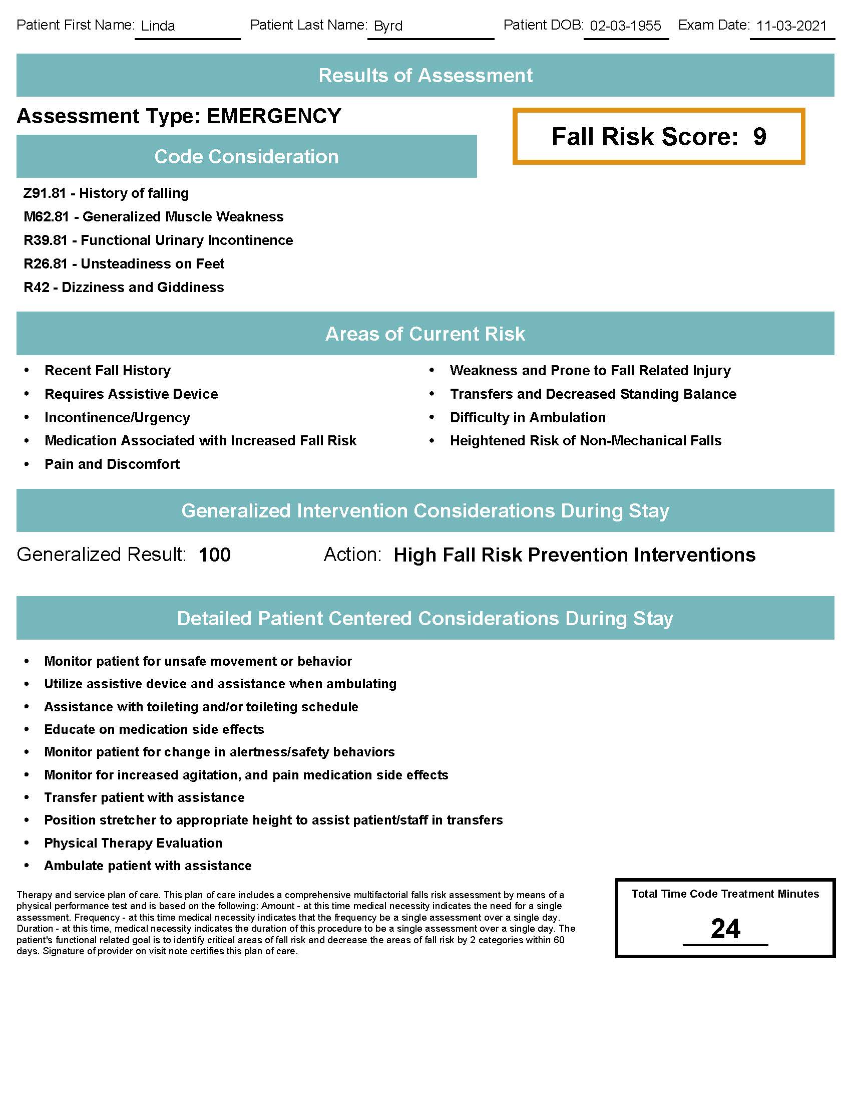
Safe Balance
Emergency Dept. to Admission Scenario
Emergency Dept.
Patient presents to ED following a fall
Inpatient/Home
Inpatient clinical staff reviews findings and implements fall prevention measures specific to risks identified in Safe Balance report alongside nursing fall prevention protocols.
Safe Balance Assessment Completed with Suggested Care Plan and Report Generated
Emergency Dept.
Patient provided discharge plan for follow up mitigation strategies with their PCP and are referred to appropriate service lines when applicable based on risks.
  Provider Reviews Results and Admits Patient to the Hospital
SAFE BALANCE® Technology | Safe Balance (safe-balance.com)

Slide 32
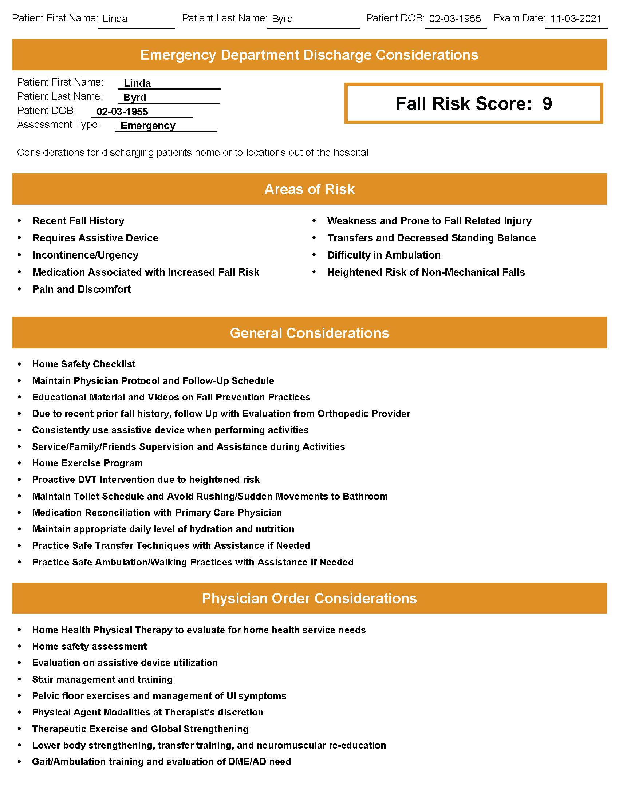
Safe Balance
Emergency Dept. to Home Scenario
Emergency Dept.
Patient Presents to ED following Exacerbation of CHF
Home
Patient engages with orders, educational materials and continues to monitor fall risk with PCP throughout the year.
Safe Balance Assessment Completed with Suggested Care Plan and Report Generated
Emergency Dept.
  Provider reviews results and discharges patient home with care plan, orders and referral to primary care physician for continued intervention of fall risk factors identified.
SAFE BALANCE® Technology | Safe Balance (safe-balance.com)

Slide 33


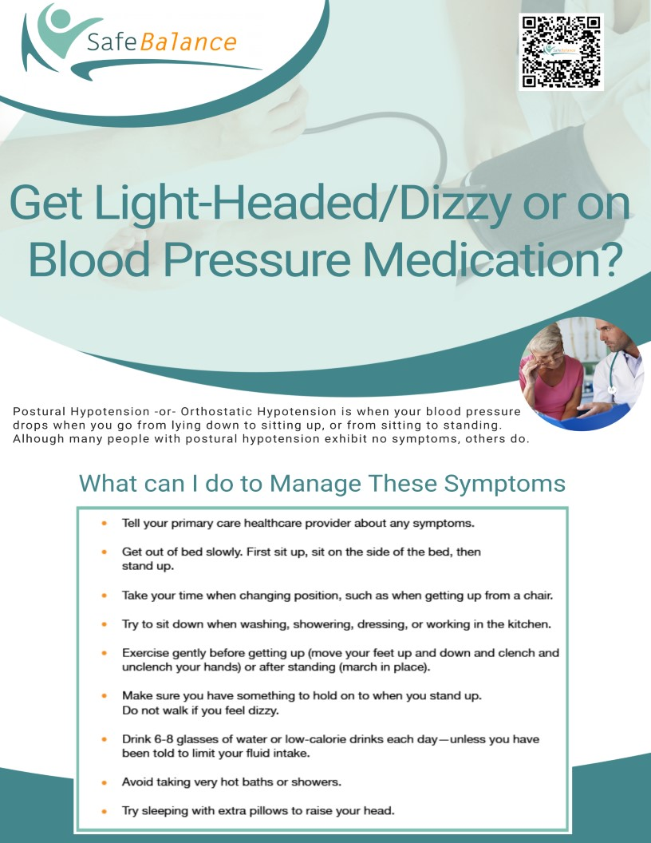
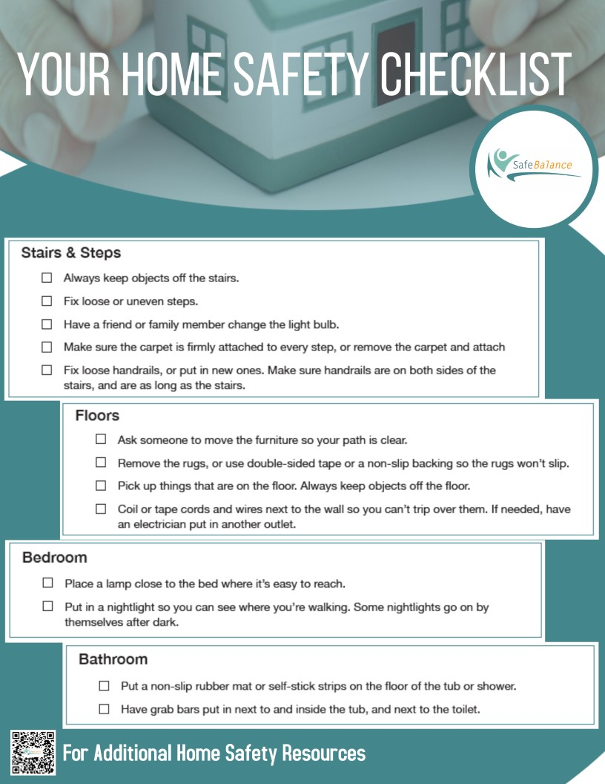
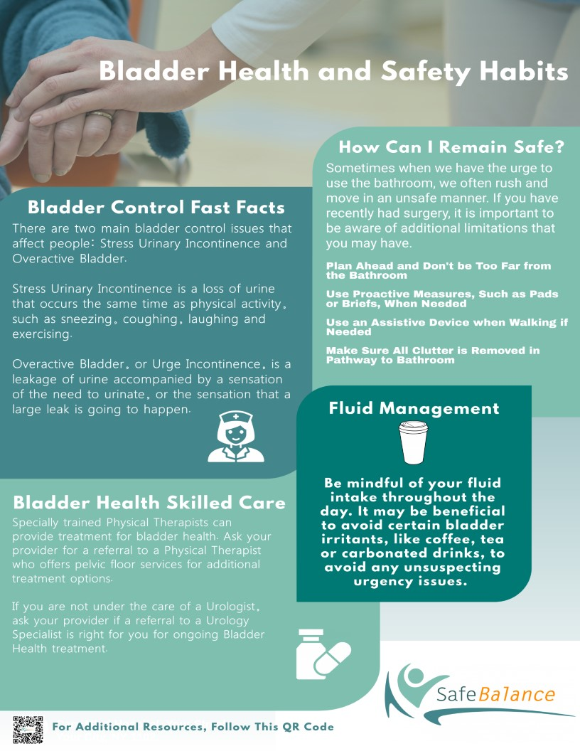
Risks Continually Managed throughout Continuum of Care
SAFE BALANCE® Technology | Safe Balance (safe-balance.com)

Slide 34

Think Vulnerable Populations:
Age: >85 years
Frailty
Known Fallers
Prior Hip Fracture
Dementia
Others…

Slide 35

Let’s Commit To Change
It is our shared responsibility to:
- Keep vulnerable patients safe!
- Integrate safe technology into the practice setting and workflow!
- Initiate individualized care plans to mitigate and eliminate fall risks!
- Promote function, and Save Lives!

Slide 36


Thank You and Please Share More!
Thank you for attending, be a Champion for Change, and keep me posted – I am here for you!
Patricia Quigley, PhD, MPH, ARNP, CRRN, FAAN, FAANP, FARN, Nurse Consultant
pquigley1@tampabay.rr.com

Slide 37

References
CDC (2021a, February 11). National Center for Injury Prevention and Control. Leading causes of death and injury, 2001-2019. Available here - Accessed June 4, 2021.
CDC (2021b). Emergency department visits and hospitalizations for selected nonfatal injuries among adults aged > 65 years – United States, 2018. Morbidity and Mortality Weekly Report. May, 2021, 70(18): 661-666. Available here - Accessed June 5, 2021.
CDC. (2017). Important Falls about Falls. Available here - Accessed Jun 2, 2021
CDC debuts injury prevention campaign for elders, says most ED visits due to falls. McKnight’s Long-Term Care News. ARN pulse. May 13, 2021
CDC STEADI (Stopping Elderly Accidents, Deaths and Injuries) (2020, July 9). Available here - Accessed June 5, 2021

Slide 38
References
Factora, R., Thomas, D., & Darowshi, A. (2021). Evaluation of falls in the elderly. BMJ Best Practice, Evaluation of falls in the elderly - Differential diagnosis of symptoms | BMJ Best Practice US
National Council On Aging. Date Sept. 22: Fall Prevention Awareness Day. Falls Prevention Awareness Day (seniorfallsprevention.org) accessed June 5, 2021
Rubenstein, L. (2021, April). Fall in older people. Merck Manual Consumer Version. Available: Falls in Older People - Older People’s Health Issues - Merck Manuals Consumer Version Accessed Jun 2, 2021

Slide 39

Product Info & References
Fall Prevention Special Focus: Emergency Departments
Nov. 17, 2021
The following slides contain the information and links referenced throughout this webinar. Please feel free to reach out to us with any questions about the information or the products.
rdavoli@curbellmedical.com

Slide 40


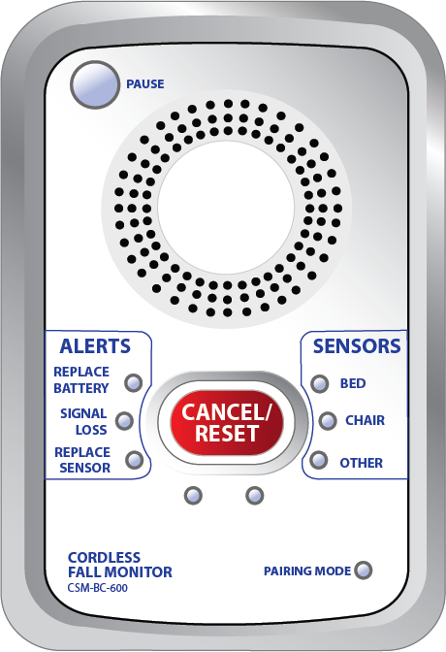



Curbell Medical
PAUSE gives the caregiver 60 seconds
to remove the patient from the sensor
without causing an alarm.
BC600 Cordless/Corded FM Monitor
Clinician Input Design! Simple to understand and easy to use for caregiver day to day use:
Clearly labeled, easy to read buttons and LED indicator lights
Setup functions kept out of sight in battery compartment
      Delay control* 
      Tone switch
Volume
Nurse call jack allows direct notification to nurse call
Silent option when connected to Nurse Call 
Can be used with both cordless and corded sensors
60 Second Alarm Pause* 
Can control up to three cordless devices at the same time
3 AA Batteries - 6 Month Battery Lifespan
SENSORS identify which
sensor initiated the alarm.
*Reduces False Alarms
Reduces Alarm Fatigue
CANCEL/RESET flashes when an
alarm is triggered making it more
noticeable for the caregiver
ALERTS show when to replace the
batteries or sensor pad and if there
is a lost signal.
Click here for more product information

Slide 41

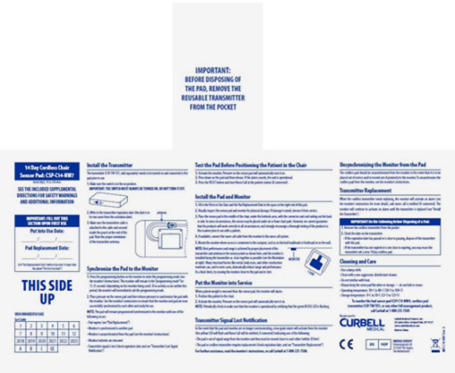
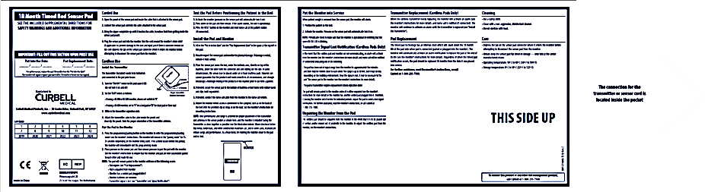
Curbell Medical
Chair Pad 7”x 15”
Short Term Corded & Cordless Sensor Pads
Single patient use sensor pads are an ideal solution when infection control is a concern:
Available in two styles:
  Corded Sensor Pad* - allows for quick easy setup and use
  Cordless Sensor Pad  - option eliminate cord tripping hazards and cord damage
Disposable – throw away after patient use.
Good up to 30 Days of use on a single patient
Smaller chair pad sizes allow for more immediate alarm notification if the patient shifts out of normal position
Bed Pad 3” x 30”
 Short term sensor pad must be used with the CSP-TW-TX45DY 90 Day Disposable Transmitter (sold separately)
* Corded sensor pad have an attached, fixed cable but a cable extension is available and sold separately
Click here for more product information

Slide 42

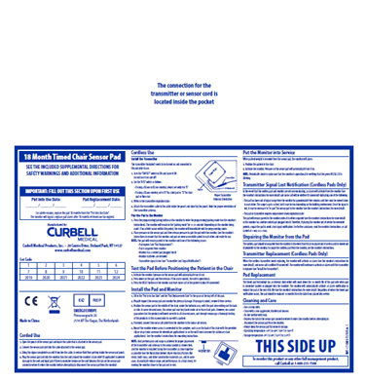
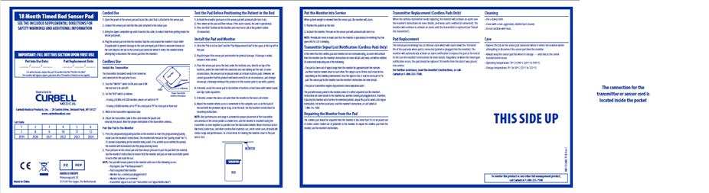
Curbell Medical
Zippered pouch VS. Velcro, addresses biohazard concerns
18-Month Corded & Cordless Sensor Pads
The 18-month lifespan is the longest in the market and is an economical solution to short-term sensor pads:
Interchangeable – can be used as a corded or cordless solution with a switch to either a cable (corded) or transmitter (cordless)
  Corded Sensor Pad* - allows for quick easy setup and use
  Cordless Sensor Pad - option eliminate cord tripping hazards and cord damage
Self Auditing - eliminates need for staff to manually track when the sensor needs to be replaced.
  Eliminates possibility of expired sensors being used with a patient
Pad sizes – bed sensor pad 10”x30”, chair sensor pads 10”x15”
 Additional accessories (cables and 18-month transmitters) can be purchased separately
* Corded sensor pad part numbers include the cable
 Cordless sensor pads include the 18-month transmitter
FOLDABLE SEAM on the bed sensor pads only allow for easy storage
Click here for more product information

Slide 43
Curbell Medical
ANTENNA to improve signal strength
CS-WMS Wireless Motion Sensor
SENSORS identify motion sensor’s status
Provides reliable infrared motion detection in light and dark conditions. It can be used as a standalone device or as an accessory for the BC600 fall management monitor. When a patient passes through the detection area, the CS-WMS will be triggered and will either sound an alarm or send a wireless signal to the BC600 to alarm:
STATUS
Can be mounted on a wall above bed, chair, doorway or above a toilet
Compatible with BC600 cordless monitors
  Can send an alert through nurse call when paired with the BC600
Narrow detection angle with adjustable distance
Stand alone option
3 AA Batteries - 6 Month Battery Lifespan
ALARM/OFF/TRANSMIT
RESET/
PAUSE
RESET/PAUSE cancels alarm or pauses from triggering 15 seconds.
TRANSMIT MODE when switched to, a signal is sent to a BC600 monitor, which is connected to the nurse call system to provide an alarm at the nurse’s station.
ALARM MODE when switched to, the Wireless Motion Sensor will sound an audible alarm when motion is detected.
Click here for more product information

Slide 44





Curbell Medical – Other FM Products
Floor Mats
Seat Belts
Toilet Sensor
18 Month Sensor Pads
Accessories
Other FM Monitors
Placed near beds, chairs, and doorways to alert staff if a patient attempts to stand or walk. Available in corded and cordless options.
In addition to setting off an alarm when unfastened, it also helps keep the patient from sliding down the wheelchair.
Mounts discreetly underneath the toilet seat so that a patient can be monitored by staff without a loss of privacy.
Reusable – durable, long-lasting (up to 18 months) sensor pads that are available for use on beds, stretchers and chairs with self-audition technology.
Mounts, clips, cables, replacement parts, transmitters and nurse call adaptors
Curbell has a selection of FM monitors to meet the need and budget of the facility; pull-string monitors, simple and advance corded only monitors.
Click here for more product information

Slide 45

Contacts:
greamsnyder@curbellmedical.com
rdavoli@curbellmedical.com
pquigley1@tampabay.rr.com

