Slide 1

Fall Prevention Webinar Series
Event sponsored by
Toileting-related Falls • Key Solutions
February 23rd, 2022

Slide 2


Toileting-related Falls:
Key Solutions
Patricia Quigley
PhD, MPH, APRN, CRRN, FAAN, FAANP, FARN
Consultant, Nurse Scientist, nationally known for her extensive clinical practice, research and publications, policy influence on patient safety, fall and fall-related injury prevention, and research translation across settings of care.
February 23rd, 2022
Event sponsored by

Slide 3




Objectives
Understand
Current evidence about toileting-related falls and urinary incontinence.
Discuss
Key solutions to individualize scheduled and assisted toileting while creating an environment for safe toileting.
Apply
Steps for progressive and successful program implementation.

Slide 4

My Hope
You will be
inspired
and guided to redesign fall prevention programs to mitigate and eliminate patient and environmental toileting fall risks, and generate strategies for a population-based approach for scheduled and assisted toileting

Slide 5
What we know:
In an unfamiliar environment;
Receiving medications that cause frequent urination as well as confusion;
Failing to realize the increase in falls without proper supervision during toileting activities
Unaware of how new medical / surgical conditions increase their fall risks;
Overestimating their abilities.
Patient falls during toileting occur because patients are:

Slide 6
The Evidences Informs Us
A large number of falls occur on the way to the toilet
A relationship exists between toileting-related falls and lower urinary tract symptoms (LUTS).
Frequency, urinary incontinence and nocturia are mostly reported in the literature as a potential fall risk attribute
Analysis of 9 of 11 falls risk scales in hospitalized patients, a LUTS or LUTS-related attribute was included
Roggerman, S., Weiss, J.R., Van Laecke, E.V, et al., (2020). The role of urinary tract symptoms in fall risk assessment tools in hospitals: a review.
Notes:
Lower urinary tract symptoms (LUTS) include voiding or obstructive symptoms such as hesitancy, poor and/or intermittent stream, straining, prolonged micturition, feeling of incomplete bladder emptying, dribbling, etc, and storage or irritative symptoms such as frequency, urgency, urge incontinence, and nocturia

Slide 7
Incontinence • A Limited Driver for Nursing Practice
In all the hospital fall risk tools reviewed from 2008 to 2019
No discrimination between urinary and bowel incontinence;
No discrepancy between risk factors during the day or night;
Urinary incontinence is a significant risk factor for older people, it is recommended to screen for bladder dysfunction on hospital admission.
While relationship between LUTS and Falls is significant, it is under-represented in fall risk scales.

Slide 8

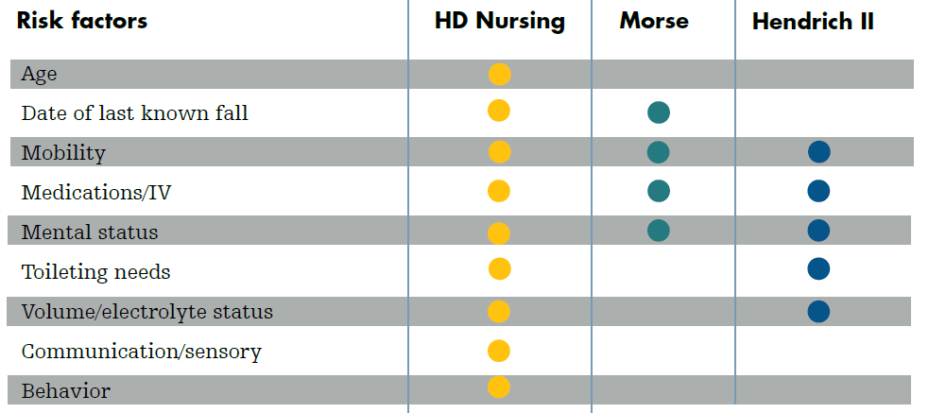

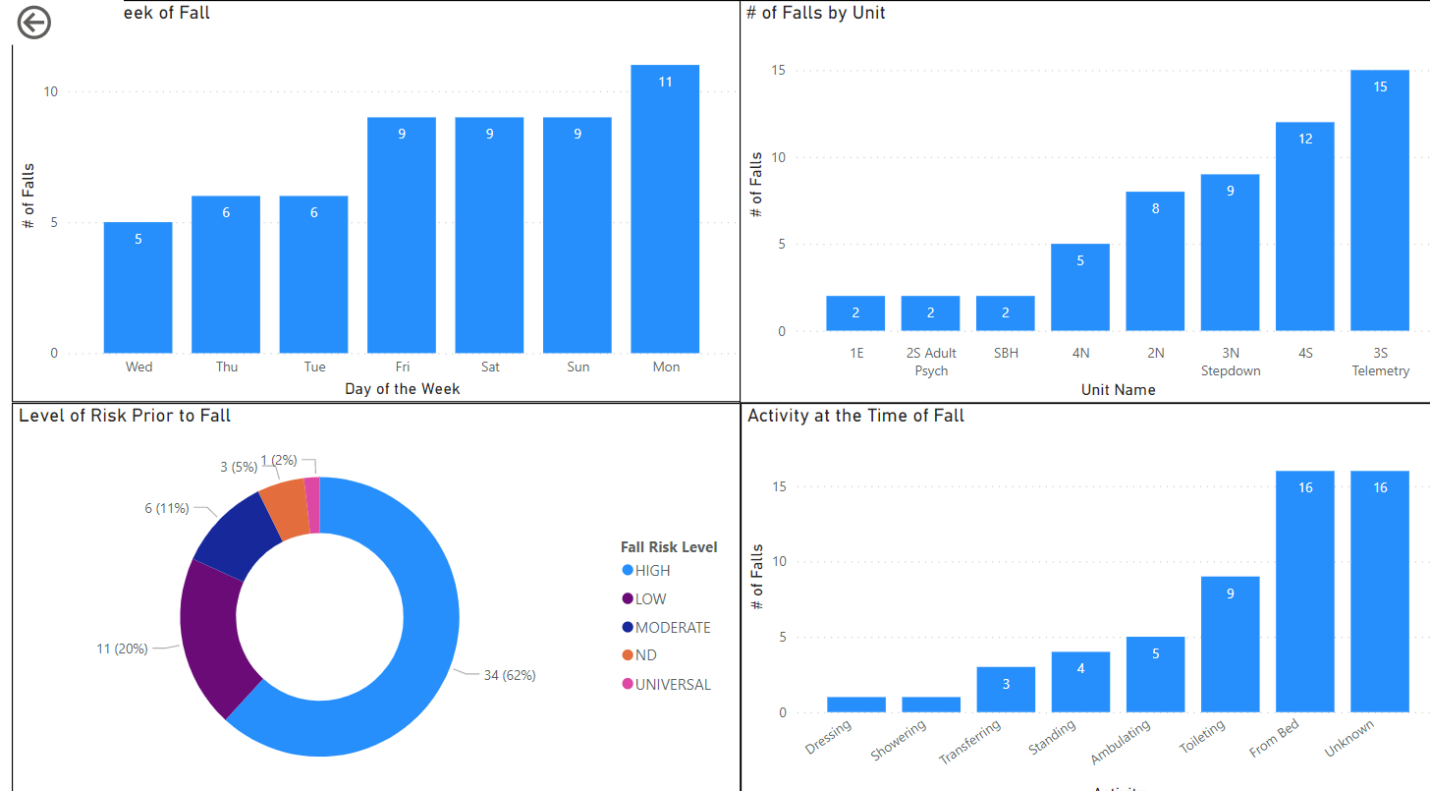
Hester Davis Falls Prevention Program©
Predict
Fall Risk
Prevent
Falls and Injuries
Sustain
Performance and
Substantial Gains
Individualized Care Plans designed to address fall risk subscales with the intervention to the right patient at the right time to prevent falls and injury.
A complete Education Plan, Toolkit and Data Analytics to make data driven, actionable decisions that sustain your gains over time.
Utilize the Hester Davis Scale to predict fall risk

Slide 9
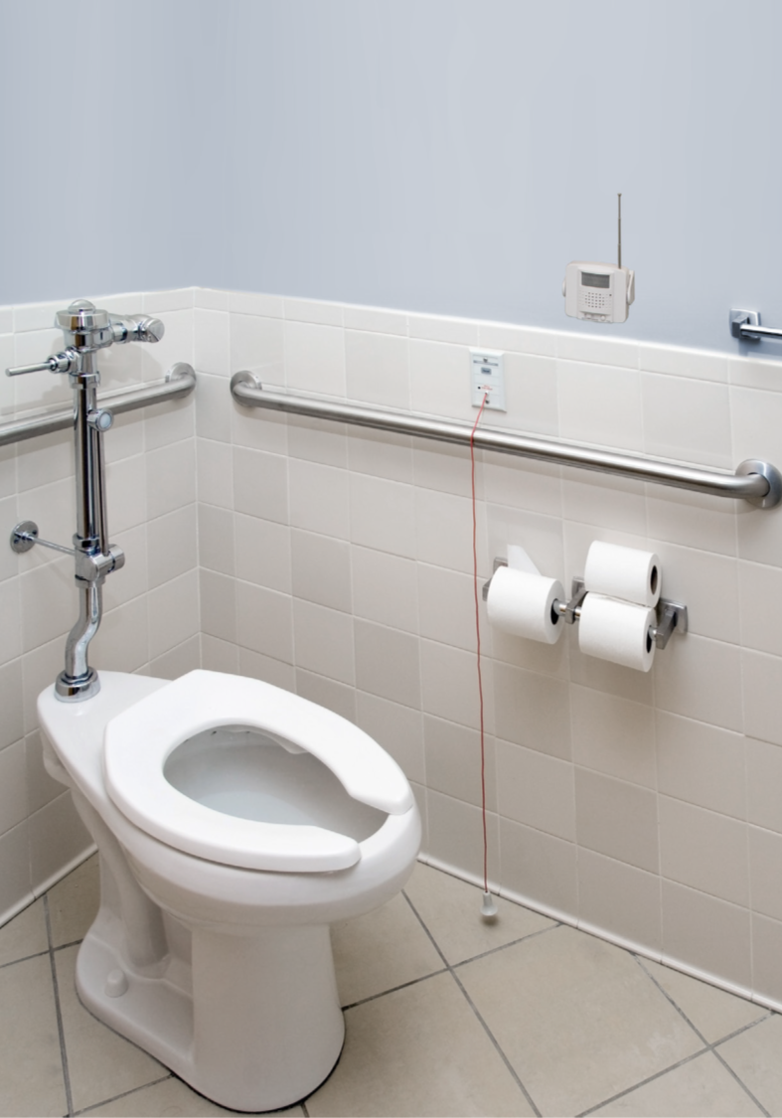
LUTS (Lower Urinary Tract Symptoms)
LUTS (lower urinary tract symptoms) are symptoms related to problems with the lower urinary tract: the bladder, the prostate and the urethra.
LUTS are broadly grouped into symptoms to do with storing or passing of urine.

Slide 10

LUTS (Lower Urinary Tract Symptoms)
Three groups of Symptoms: storage, voiding and post-micturition symptoms
Storage symptoms that are most relevant: increased daytime urinary frequency (voiding more times that 8 times a day); nocturia (waking to pass urine during the main sleep period); and urinary incontinence (any involuntary leakage)
LUTS share common causal pathways with frailty

Slide 11
Urinary Urgency and Mobility
Urinary urgency shown to reduce walking speed by inducing shorter step length, greater gait variability and a more flexed posture.
Compounded by existing impaired balance, muscle weakness and co-morbid illness that increases rate of urine production
46% of all falls at night in subacute hospitalized patients occur on the way to the toilet
The risk of injurious falls is significantly greater in patients who wake to void compared to people who sleep through the night.
A recent systematic review concluded that nocturia increases the relative risk of falls by 20% and fractures by 32% (Pesonen, et al., 2020)
Notes:
Risk Ratio vs Odds Ratio
A RR of 3 means the risk of an outcome is increased threefold. A RR of 0.5 means the risk is cut in half. But an OR of 3 doesn't mean the risk is threefold; rather the odds is threefold greater.
17. Pesonen JS, Cartwright R, Vernooij RWM, et al. : The Impact of Nocturia on Mortality: A Systematic Review and Meta-Analysis. J Urol. 2020;203(3):486–95. | 10.1097/JU.0000000000000463 [PubMed] [CrossRef] [Google Scholar] F1000 Recommendation

Slide 12
Toileting-related Falls at Night (2019, Rose, et al.)
Describe prevalence and characteristics of toileting-related falls in hospitalized older adults
Retrospective analysis of falls related to night-time toileting in patients 60 years of age and older over 1-YR period of time
34% of fall related to toileting with at least 44% occurring during the night
Peaked 11pm-1am, maximum supine-induced diuresis
About 50% of night falls occurred at bedside
Half had no strategies for toileting documented in care plan
Notes:
Rose, G., Decalf, V., Everaert, K., Bower, W. (2019, July 18). Toileting-related falls at night in hospitalized patients: The role of nocturia. Australasian Journal on Ageing, https://doi.org/10.1111/ajag.12696

Slide 13
Toileting-related Inpatient Falls (2012, Tzeng & Yin)
547 falls July 2005-2008
247 (45.2%) associated with toileting
87 (15.9%) on the way from bed or bedside chair to the bathroom or back
70 (12.8%) getting out of or back to bed
55 (10.1%) slipped off the toilet or bedside commode
27 (5.0%) moving from bed to BSC or back
8 (1.4%) using urinal while standing or sitting on edge of bed or chair
Archived falls over three year period; four inpatient units
Notes:
Tzeng, H-M., Yin, C-Y. (2012). Toileting-related inpatient falls in adult acute care settings. MEDSURG Nursing, 21(6): 372 -377.
Retrospective exploratory study – 4 adult inpatient units

Slide 14
Prevalence of Inpatient Falls Associated with Toileting (2010, Tzeng)
Qualitative Study Michigan Hospital
Archived falls over three year period; four inpatient units
547 falls July 2005-2008
45.2% of all falls related to toileting
Most common theme – falling on the way from the bed or chair to the bathroom
Nurses: focus on safe patient transfers / safe mobility
Develop individualized prevention plan of care
Notes:
Tzeng, H-M. (2010). Understanding the prevalence of inpatient falls associated with toileting in adult acute care settings. JNCQ, 25(1): 22-30. doi: 10.1097/NCQ.0b013e3181afa321.

Slide 15
Patient-Specific
Fall Risk Factors
Patient‘s underlying fall risk factors
Problems with walking and transfers
Medication side effects
Confusion
Frequent toileting needs
Orthostatic hypotension
Balance and Mobility Issues

Slide 16
Patient Assessment
Cognitive Status – Judgement
Communication Status
Balance – Sitting, Standing
Ambulatory Status (level of assistance)
Assisted Mobility (Contact Guard vs Standby Assist)
Sensory Neuropathy
Continence / Incontinence Symptoms
Orthostasis
(If falls due to intrinsic fall risk factors, Anticipated Physiological Falls)

Slide 17
Environmental Risk and Assessment
Bed height
Safe exit side (bed transfer side),
Pathway to the bathroom,
Toilet access and placement
Toilet height
Bilateral Folding Grab Bars
Bedside Commode vs. Raised Toilet Seat
Bathroom Lighting
(If fall due to environmental extrinsic factors, is Accidental Fall)

Slide 18
Redesigned for Patient Safety

Slide 19
Interaction Effect • Patient and Environnent
Fall prevention involves:
Manage patient‘s underlying fall risk factors (e.g., problems with walking and transfers, medication side effects, confusion, frequent toileting needs) and
Optimize the hospital‘s physical design and environment (toilet height, grab bars, mobility devices). (Ganz, et al, 2013)
Maximize safe mobility: Assisted bed exit; SBA vs. CG; Device – wc vs ambulatory aid
Individualize progressive toileting program

Slide 20
Solutions
Environmental Design – Pathway to the bathroom and actual bathroom
Equipment Resources – Sensors, Mobility Aides, Gait Belts
Care Delivery Model – Primary / Team Nursing
Communication Methods – Huddles, White Boards, Nurse Call Systems
Surveillance Methods – PEVS, Rounding
Staffing and Skill-mix – Resources per shift
Available Technology – Sensors, Surveillance, Nurse Call Systems

Slide 21



Three Areas of Action • Proactive Toileting
Recommendations to reduce patient fall rates can be grouped into three categories:
Educating both staff and patients
Fall risk using standardized measurement
Implementing interventions such as increased staffing and technology use
Swenson, P., Besaw, K., Olmstead, J. (2019). Fall prevention using proactive toileting. Nursing Management, 50(12); p. 16-18. Acute Rehab Unit
Notes:
Swenson, et al., What they discovered: toliteling schedule was not hardwired – was a suggested timeframe. Relied on patients to ask for assistance to toilet – which failed. Needed program where nursiung staff said time to toilet, and no option to decline.
Hardwired scheduled toileting 2 times day shift, 2 times evening shift, 1 time night shift … time to take the pt. If refused, the pt was asksed for a time to toilet. Decreased falls by 50% and no falls for 65 days.

Slide 22
Bathroom
Minnesota Hospital Association (MHA), the
“Creating a Safe Environment to Prevent Toileting Related Falls Report” (2014)
includes guidance for hospitals for creating a safer environment that supports patient safety while accessing and using the toilet.
Commissioned research project to better inform environmental factors and generate recommendations for safer bathrooms
Examples:
Grab Bars
Toilet Height
Line of Sight
SAFE DESIGN (2014)
https://www.mnhospitals.org/Portals/0/Documents/ptsafety/falls/CreatingASafeEnvironmenttoPreventToiletingRelatedFallsReport.pdf

Slide 23
SAFE DESIGN
Simplify path to toilet
Amplify lighting levels
Finish and furniture selection
Entry and type of shower
Door design
Evaluate toilet height and location
Smart storage solution
Increase color contrast
Grab bar installation
Needs of patients

Slide 24

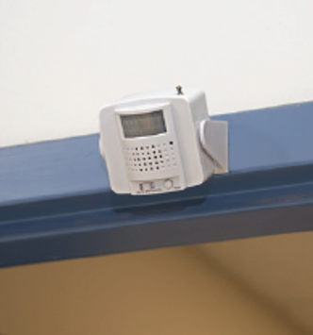

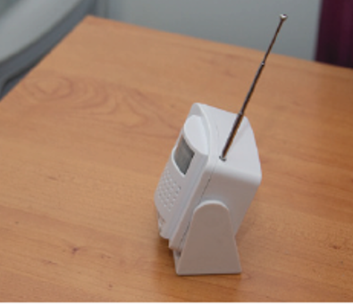


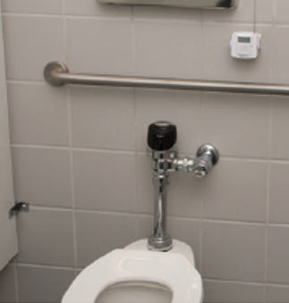
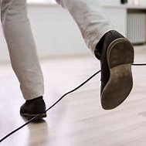
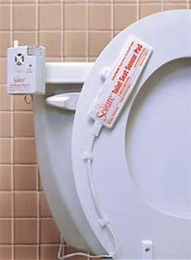
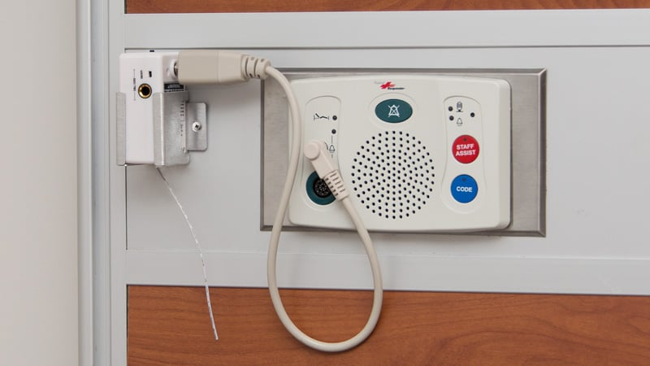

Curbell Toileting Solutions
Mount on a Wall Above a Doorway
Place on Flat Surface Like a Shelf or Table
Mount Above or next to the Toilet
Eliminates Tripping Hazards
Replaces Traditional Toilet Seat Sensors
Connects to Nurse Call Through the BC600*
Wireless Motion Sensor
Will alarm to notify staff if the patient enters the toileting area unattended or can be position to be used when a patient is getting of the toilet without assistance
Notes:
MOTION SENSOR The CS-WMS Wireless Motion Sensor can be used as a standalone device or as an accessory for the BC600 Fall management monitor that connects into nurse call systems. When a patient passes through the detection area the CS-WMS will be triggered and will either alarm or send a wireless signal to the BC600 to alarm. The CS-WMS is cordless and can be placed on a night stand or be mounted on a wall.
TOILET SENSOR PAD This sensor mounts discreetly underneath the toilet seat so that a patient can be monitored by staff without a loss of privacy.

Slide 25
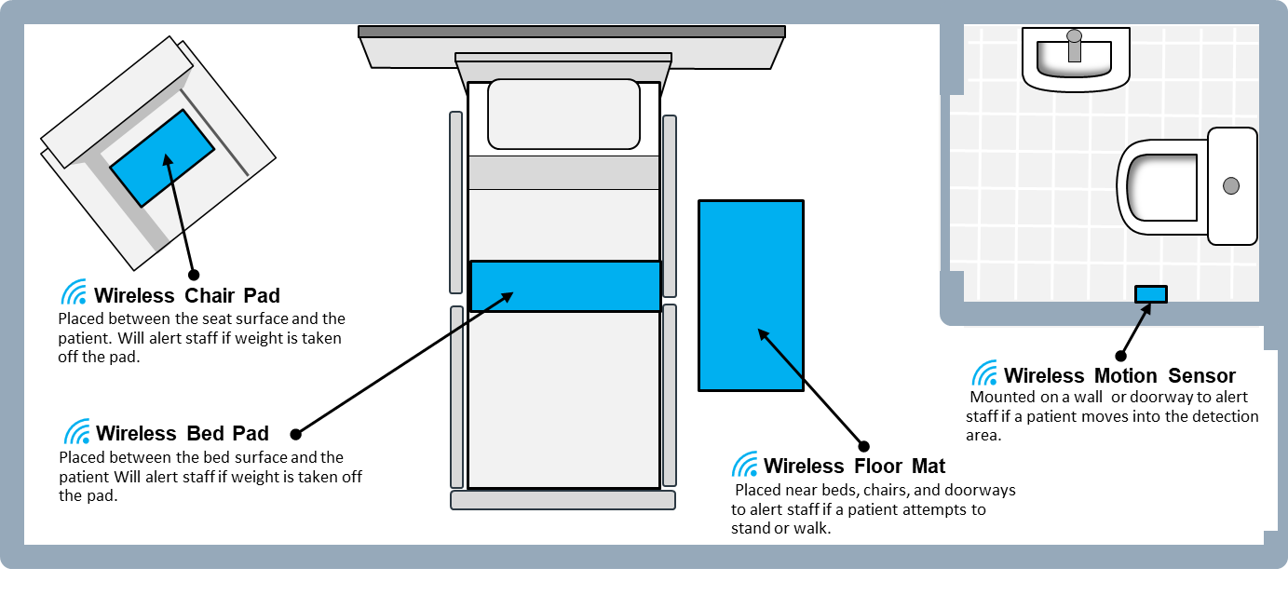
Curbell Wireless Sensors for the Hospital Room

Slide 26
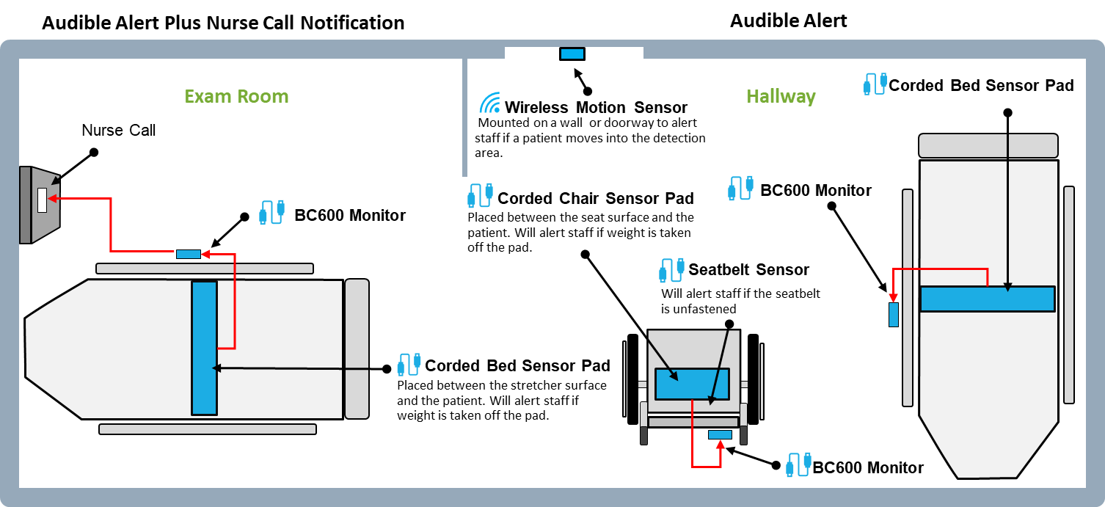
Curbell Sensors for the ER

Slide 27
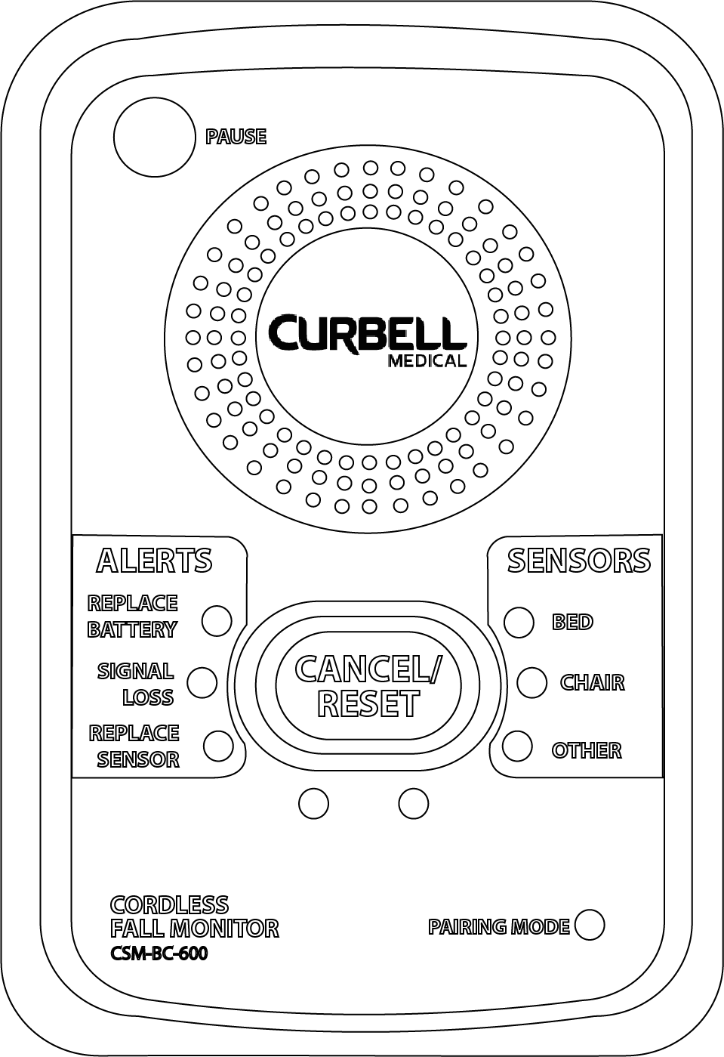


How it works with Nurse Call
Wireless Sensors
BC600 Monitor
Nurse Call
Curbell Sensors placed on the bed, chair, stretcher, floor or toileting area and are connected to the BC600 Monitor.
The BC600 would alarm when the Curbell Sensor is triggered due to patient movement.
The BC600 is connected into the Nurse Call System using a cable with a ¼” jack and when the BC600 alarms, a notification will be sent through nurse call* to alert Nursing.
Notes:
The BC600 has the ability to do “silent monitoring” and will only send notification through nurse call without the alarm going off in the room

Slide 28
Preventing Falls At During the Night
Goal: Assisted Bed Exit, Assisted Mobility to and from BR, Assisted Mobility in BR, Prevented Fall
Technology to know when patient is getting up OOB: Surveillance, Motion Sensors, Silent Sensory Technology
Safe Exit Side
Bed Height
Limit fluids after 8p
Scheduled toileting around 1am
Decided best method of assisted mobility: bed exit, ambulation vs. w/c
Incontinence Briefs
Bathroom Lighting ambient and motion sensor– eliminate switches

Slide 29
Integrate Technology
Combine Call Lights with Teach Back
Repurpose Bed Alarms to Position Change Alarms
Strategize Staff Response
Script Message to Resident: Reminder to Wait for a Nurse
See:
Quigley, P. (2019, Dec.) White Paper: Re-purposed Alarm Une for Residents in Nursing Homes: Nurse Response and Patient Fall Management Program. Prepared for Curbell Medical, Inc
Quigley, P. (2019, Dec.) White Paper: Nurse Response and Patient Fall Management Program. Prepared for Curbell Medical, Inc

Slide 30
Solutions for Successful Toileting Program Launch
Building a business case that moves this project to the top of the pile; frame program in terms that fit with organizational priorities
Anticipate pockets of resistance and initiate proactive efforts to get support
Obtain convincing pilot data to demonstrate the scope of the problem
Identify a champion
Address up front, any possible fears and concerns related to any past failures – too much of an obstacle?
  Get approval to pilot only as a start

Slide 31
Successful Resource Allocation
If resources are limited, concentrate on one unit, rather than trying to implement facility-wide. Pick an area likely to succeed to help you “sell” idea to spread program later.
Start with low tech solutions, but do not oversell what these program elements have to offer.
Look for creative funding streams.

Slide 32
Gain Support at All Levels
Market your program– need salesmanship
Be flexible in how you pitch the idea, targeting specific interests of each group:
  CEO: Cost/benefit analysis
  Director Nursing: Magnet Status, Regulatory Requirements
  Nurse Manager: Best Practices
  Staff Nurse: Impact on Quality of Care, Keeping up to date with practices
  Patient: Improved safety and dignity
Include front line staff in the design and implementation planning

Slide 33
Solutions for Toileting Program Problems
Program needs much attention in beginning to iron out the rough spots or staff will get frustrated and give up. Listen carefully to problems and FIX THEM.
Build in redundancy– co-champion; peer leaders each shift, etc.
Develop proactive plans to address laundering issues (hip protectors) and equipment maintenance.
Lots of feedback and efforts to support program

Slide 34
Solutions for Program Maintenance
Champion at the facility level
Peer Leaders at unit level
Communication and feedback
Be responsive when problems are identified: While you may not be able to fix the problem fast– keep staff updated on what actions are being taken.
Incentives
Develop a written policy to clarify the roles and responsibilities of all staff
Develop implementation toolkit to make it easier to implement at unit level

Slide 35
Solutions for Perfecting Program
Implement in phases
Focus on one task facility wide
Focus on one unit/service at a time
Rather than focus on pre/post evaluation, focus on continuous improvement, making refinements over time.
You cannot give out too much credit – look for ways to pat MANY on the back

Slide 36

Next Steps
What is universal? All care must be individualized! That includes toileting… bathroom safety
Select 2-3 ideas for change
Use Small Tests of Change
Implement with commitment to succeed
Keep track of your journey

Slide 37
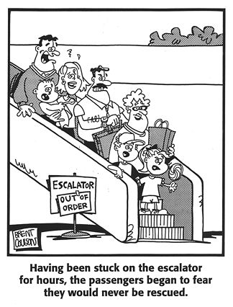
Solutions are not always obvious

Slide 38
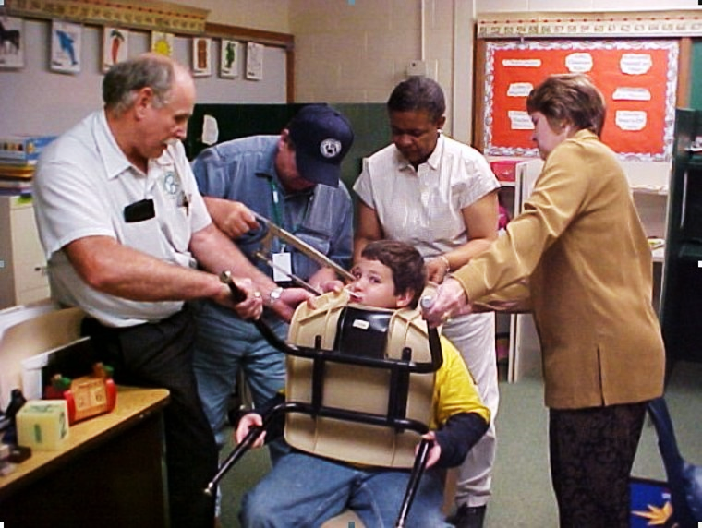

Slide 39

We share the same duty and goals to preserve and advance patients’ function and safety, mitigating and eliminating fall risks.
We are One in Mission and Purpose
39

Slide 40

May 25th, 2022
Strategies to Reducing Repeat Falls - Post Fall Management
Aug 24th, 2022
Strategies to Reducing the Risk for Hip Fractures
Sept 21st, 2022
National Fall Prevention Day • Program Evaluation: Increasing Program Evaluation Precision
Mark your calendar for future webinars
40

Slide 41
Thank You!
I hope this helps!

Slide 42

Fall Prevention Webinar Series
Event sponsored by
Toileting-related Falls • Key Solutions
February 23rd, 2022
The following slides contain the information and links referenced throughout this webinar. Please feel free to reach out to us with any questions about the information or the products.
greamsnyder@curbellmedical.com

Slide 43
References
ECRI Institute’s Top 10 Patient Safety Concerns for Healthcare Organizations (2014). List by ECRI Institute PSO to publicly share patient safety feedback based on its database of patient safety events. Retrieved from https://www.ecri.org/Resources/Whitepapers_and_reports/2014_Top_10_Hazards_Executive_Brief.pdf
Ganz, D.A., Huang, C., Saliba, D., Shier, V., Berlowitz, D., Lukas, C.V., et al. (Jan. 2013). Preventing Falls in Hospitals: A Toolkit for Improving Quality of Care. Rockville, MD: Agency for Healthcare Research and Quality. AHRQ Publication No. 13-0015-EF.
Haines, T.P., Day, L., Hill, K.D., Clemson, L., Finch, C. 2014. Better for others than for me: a belief that should shape our efforts to promote participation in falls prevention strategies. Archives Gerontology Geriatrics. 59, 136-44.
43

Slide 44
References
Hitcho, E.B., Krauss, M.J., Birge, S., Dunagam, W.C., Fischer, I., Johnson, S., Nast, P.A., Costantinou, E., & Fraser, V.J. (2004). Characteristics and circumstances of falls in a hospital setting. Journal of General Internal Medicine, 19(7), 732-739.
Inouye SK, Brown CJ, Tinetti, ME. Perspective: Medicare, nonpayment, hospital falls and unintended consequences. N Engl J Med. 2009 Jun 4;360(23):2390-3. DOI: 10.1056/NEJMp0900963
Minnesota Hospital Association, the “Creating a Safe Environment to Prevent Toileting Related Falls Report” (2014) includes guidance for hospitals for creating a safer environment that supports patient safety while accessing and using the toilet. Retrieved from
  https://www.mnhospitals.org/Portals/0/Documents/ptsafety/falls/CreatingASafeEnvironmenttoPreventToiletingRelatedFallsReport.pd
44

Slide 45
References
Roggeman, S., Weiss,J.P., Van Laecke, E., et al. (2020). F1000Res., 2020; 9: F1000 Faculty Rev-236. Retrieved from https://www.ncbi.nlm.nih.gov/pmc/articles/PMC7135676/
Rose, G., Decalf, V., Everaert, K., Bower, W. (2019, July 18). Toileting-related falls at night in hospitalized patients: The role of nocturia. Australasian Journal on Ageing. Retrieved from https://doi.org/10.1111/ajag.12696
Sonnad. S.S.., Mascioli, S., Cunningham, J., & Goldsack, J. (2014). Do patients accurately perceive their fall risks? Nursing. 44(11): 58-62.
45

Slide 46
References
Swenson, P., Besaw, K., Olmstead, J. (2019). Fall prevention using proactive toileting. Nursing Management, 50(12); p. 16-18. Acute Rehab Unit
Quigley, P. (2019, Dec.) White Paper: Re-purposed Alarm Use for Residents in Nursing Homes: Nurse Response and Patient Fall Management Program. Prepared for Curbell Medical, Inc. Retrieved from http://z5h.45f.myftpupload.com/wp-content/uploads/pdfs/white_papers/white_paper-patient_restraint_and_safety_insight.pdf
HD Nursing was founded by Dr. Amy Hester and Dees Davis, who recognized the critical problem of patient falls and the need to find a solution. The HD Falls Prevention Program is recognized as the premier evidence-based falls prevention program. Hester Davis Falls Prevention Program
46

Slide 47
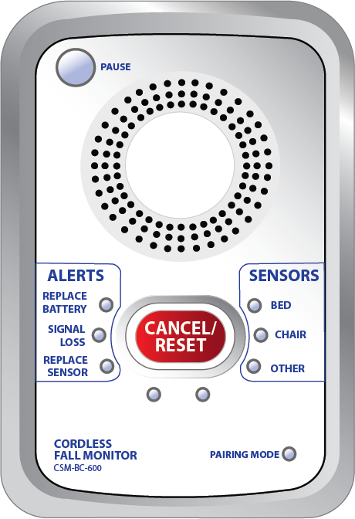


BC600 Cordless/Corded FM Monitor
PAUSE gives the caregiver 60 seconds
to remove the patient from the sensor
without causing an alarm.
Clinician Input Design! Simple to understand and easy to use for caregiver day to day use:
Clearly labeled, easy to read buttons and LED indicator lights
Setup functions kept out of sight in battery compartment
      Delay control* 🞡
      Tone switch
Volume
Nurse call jack allows direct notification to nurse call
Silent option when connected to Nurse Call 🞡
Can be used with both cordless and corded sensors
60 Second Alarm Pause* 🞡
Can control up to three cordless devices at the same time
3 AA Batteries - 6 Month Battery Lifespan
SENSORS identify which
sensor initiated the alarm.
*Reduces False Alarms
🞡Reduces Alarm Fatigue
CANCEL/RESET flashes when an
alarm is triggered making it more
noticeable for the caregiver
47
Click here for more product information
ALERTS show when to replace the
batteries or sensor pad and if there
is a lost signal.

Slide 48
CS-WMS Wireless Motion Sensor
ANTENNA to improve signal strength
Provides reliable infrared motion detection in light and dark conditions. It can be used as a standalone device or as an accessory for the BC600 fall management monitor. When a patient passes through the detection area, the CS-WMS will be triggered and will either sound an alarm or send a wireless signal to the BC600 to alarm:
SENSORS identify motion sensor’s status
STATUS
Can be mounted on a wall above bed, chair, doorway or above a toilet
Compatible with BC600 cordless monitors
Narrow detection angle with adjustable distance
Stand alone option
3 AA Batteries - 6 Month Battery Lifespan
ALARM/OFF/TRANSMIT
RESET/
PAUSE
RESET/PAUSE cancels alarm or pauses from triggering 15 seconds.
TRANSMIT MODE when switched to, a signal is sent to a BC600 monitor, which is connected to the nurse call system to provide an alarm at the nurse’s station.
ALARM MODE when switched to, the Wireless Motion Sensor will sound an audible alarm when motion is detected.
48
Click here for more product information

Slide 49
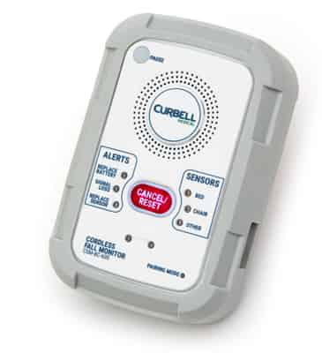
Curbell Medical
Bed
Sensor Pads
Chair
Sensor Pads
Fall Management Monitors
Fall Management Products
Floor Mat
Sensor
Seat Belt
Sensor
Fall Management Accessories

